Slide 1

Why diversify the Early Years workforce?
Jo Warin
GenderEYE

Slide 2


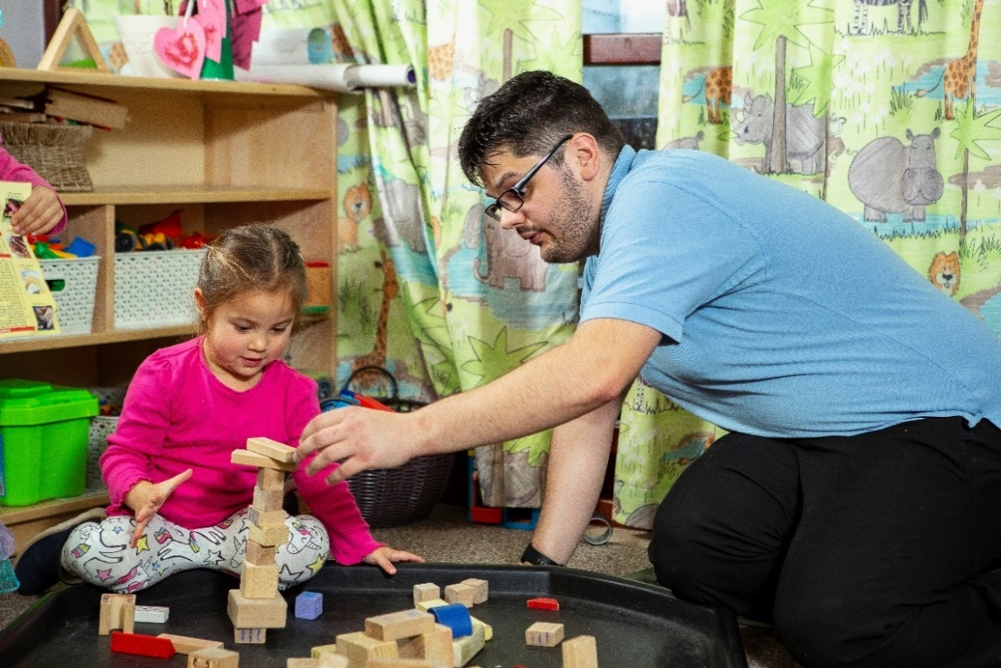



GenderEYE

Slide 3
GenderEYE.
The story so far…
Aims
Approaches
Progress

Slide 4
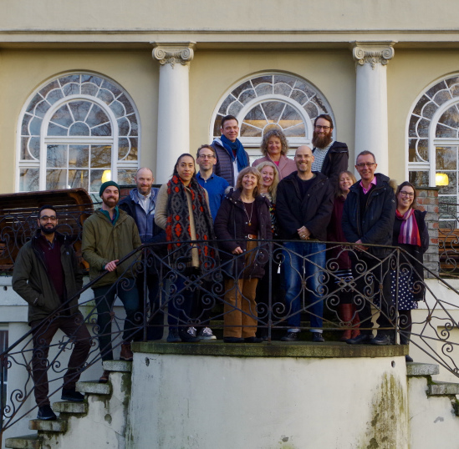
Knowledge Exchange conference in Norway

Slide 5
Our survey
Help us to get a much more accurate picture of the famous ‘3%’ statistic that represents the number of men in the Early Years workforce
Take the shortest survey ever!

Slide 6

Why gender diversity ?
A clear rationale

Slide 7

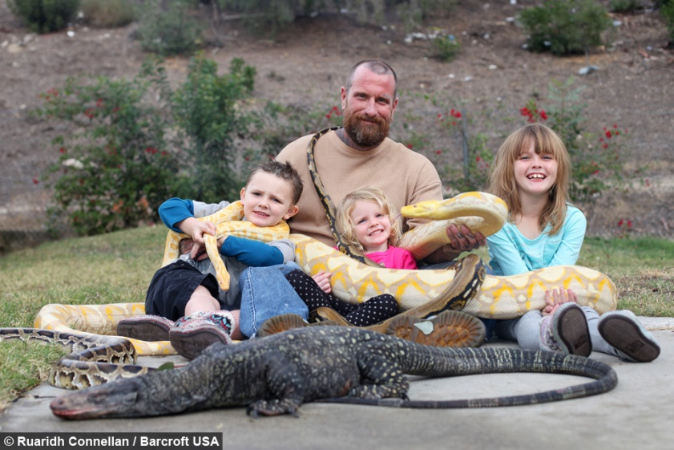
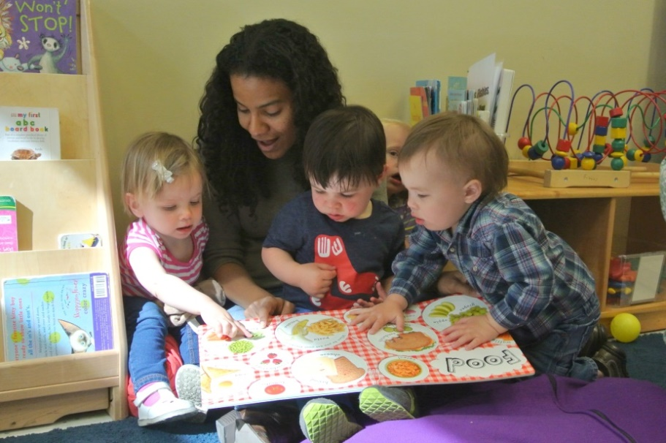
Gender balance ?
Complementary (different) roles

Slide 8
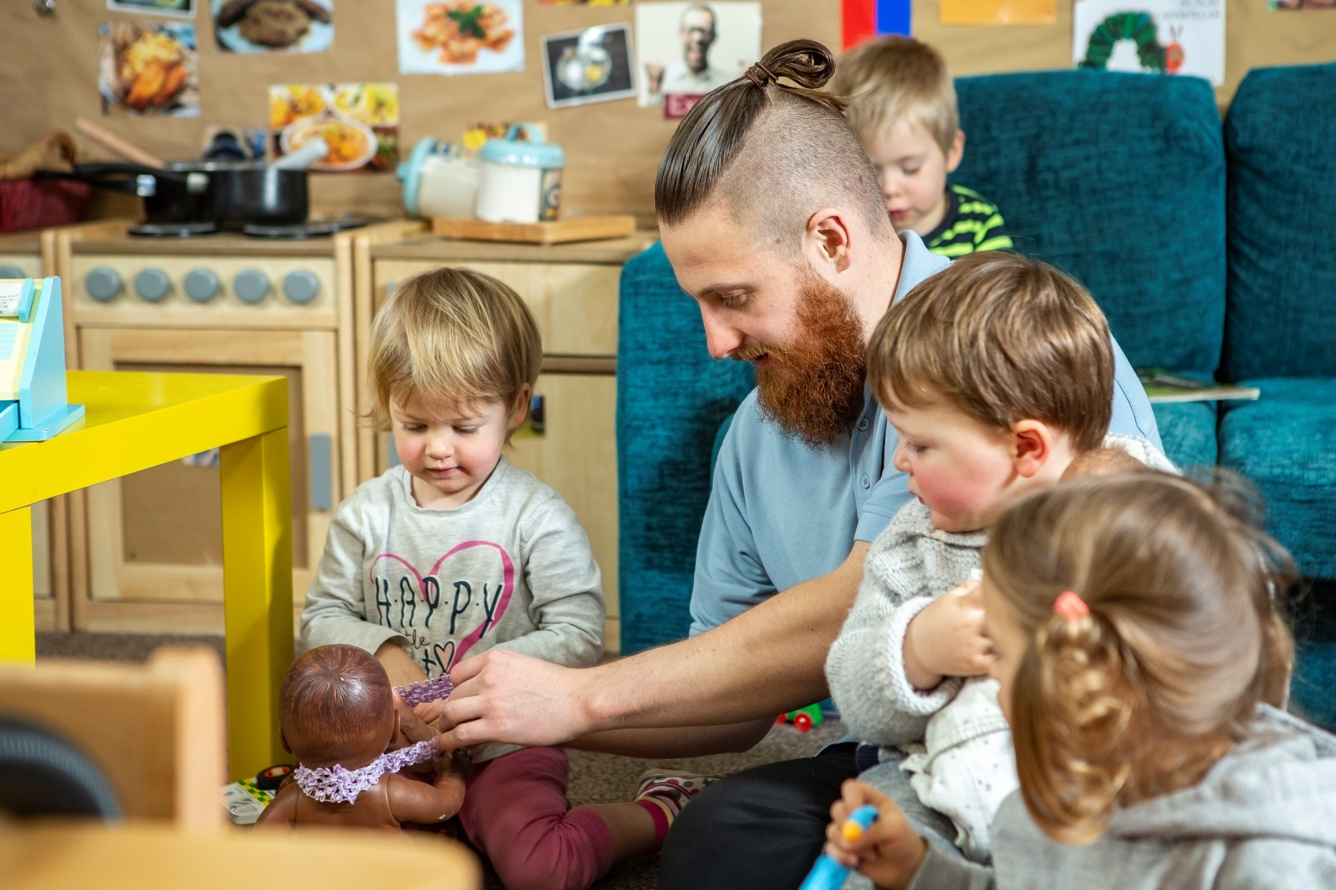
Gender flexibility

Slide 9
Who benefits?
The sector
Wider society
A new generation of children

Slide 10
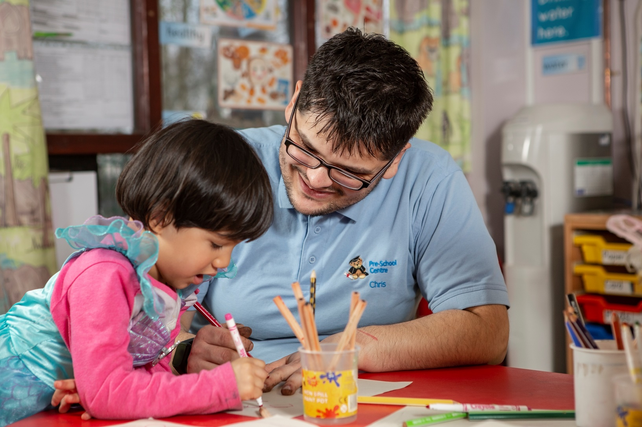
Men enjoy the work !

Slide 11
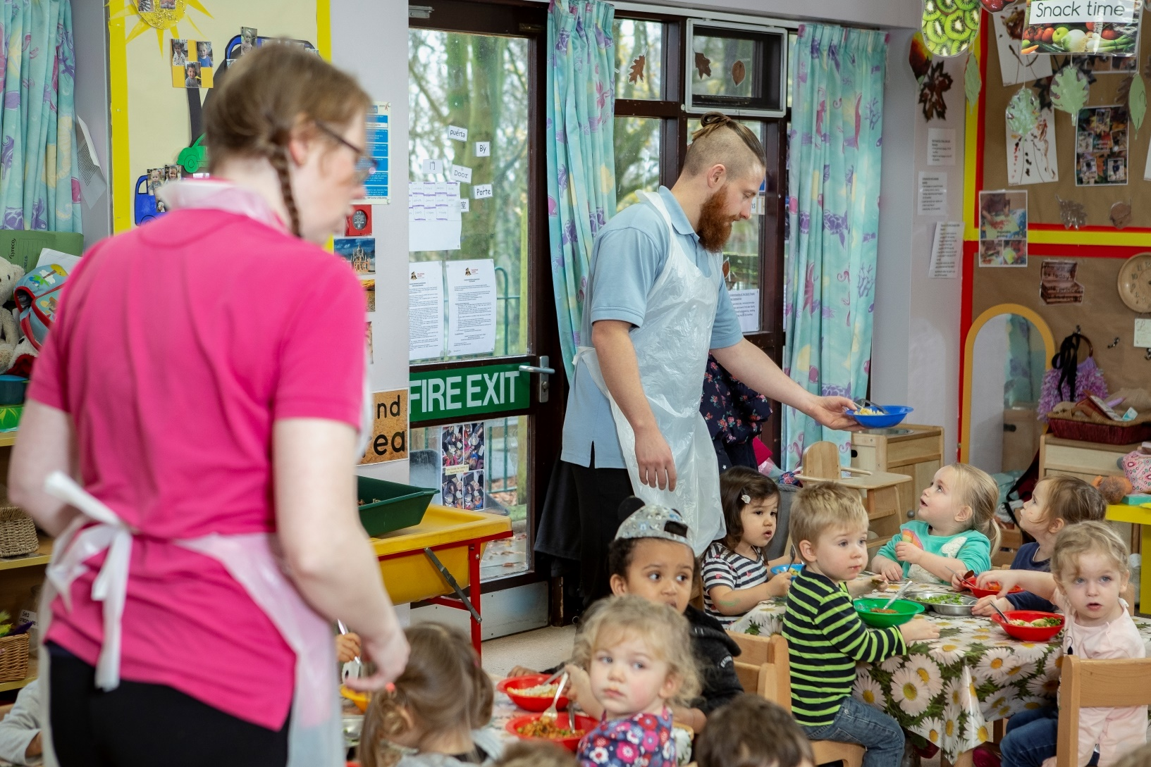
Men and women work together in interchangeable roles

Slide 12
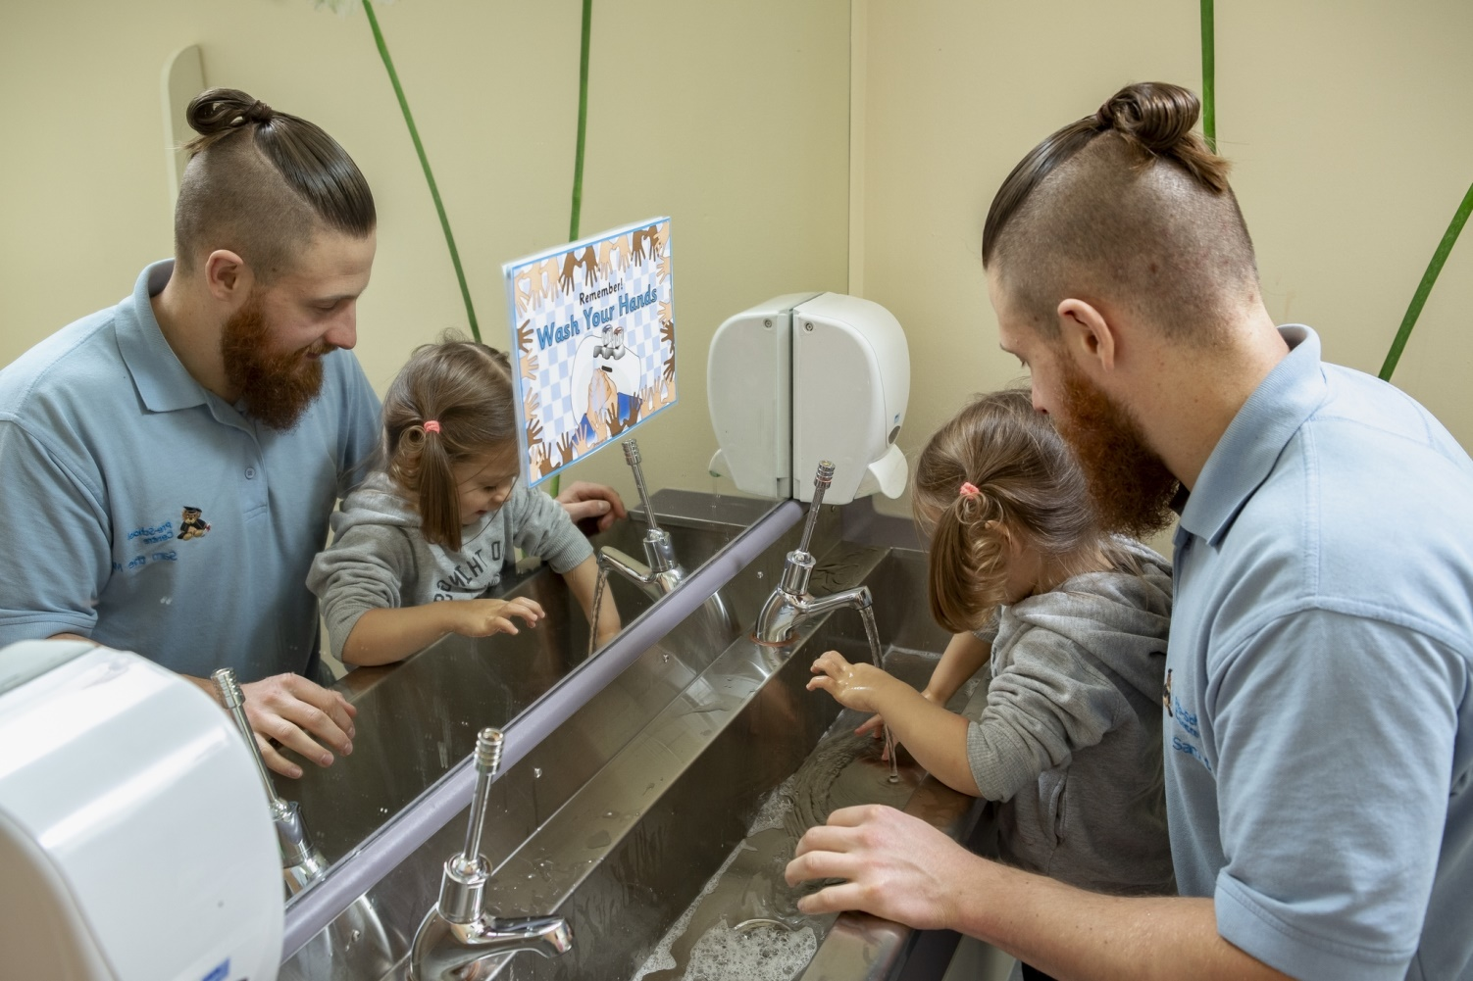
Children experience men’s care

Slide 13
