Slide 1


“How do you solve a problem like attracting, recruiting, retaining and developing men in the Early Years?”
Dr. Simon Brownhill and David Wright
MITEY 2019 Conference
London, September 2019
Notes:
SPB 1.5mins
Welcomes, thanks, introductions, mobile phones.
Aim of interactive workshop is to try and offer some possible answers to this quite enormous question (think Sound of Music)!
Any questions before we start?

Slide 2


Notes:
DW 1min
Joke: We know that trying to find a man in the EY is like trying to find Wally/Waldo in a children’s illustrated book.
BTW, if any of you are interested, I actually could not find Wally in the picture so I have kind of cheated here! [click] Ta da!

Slide 3
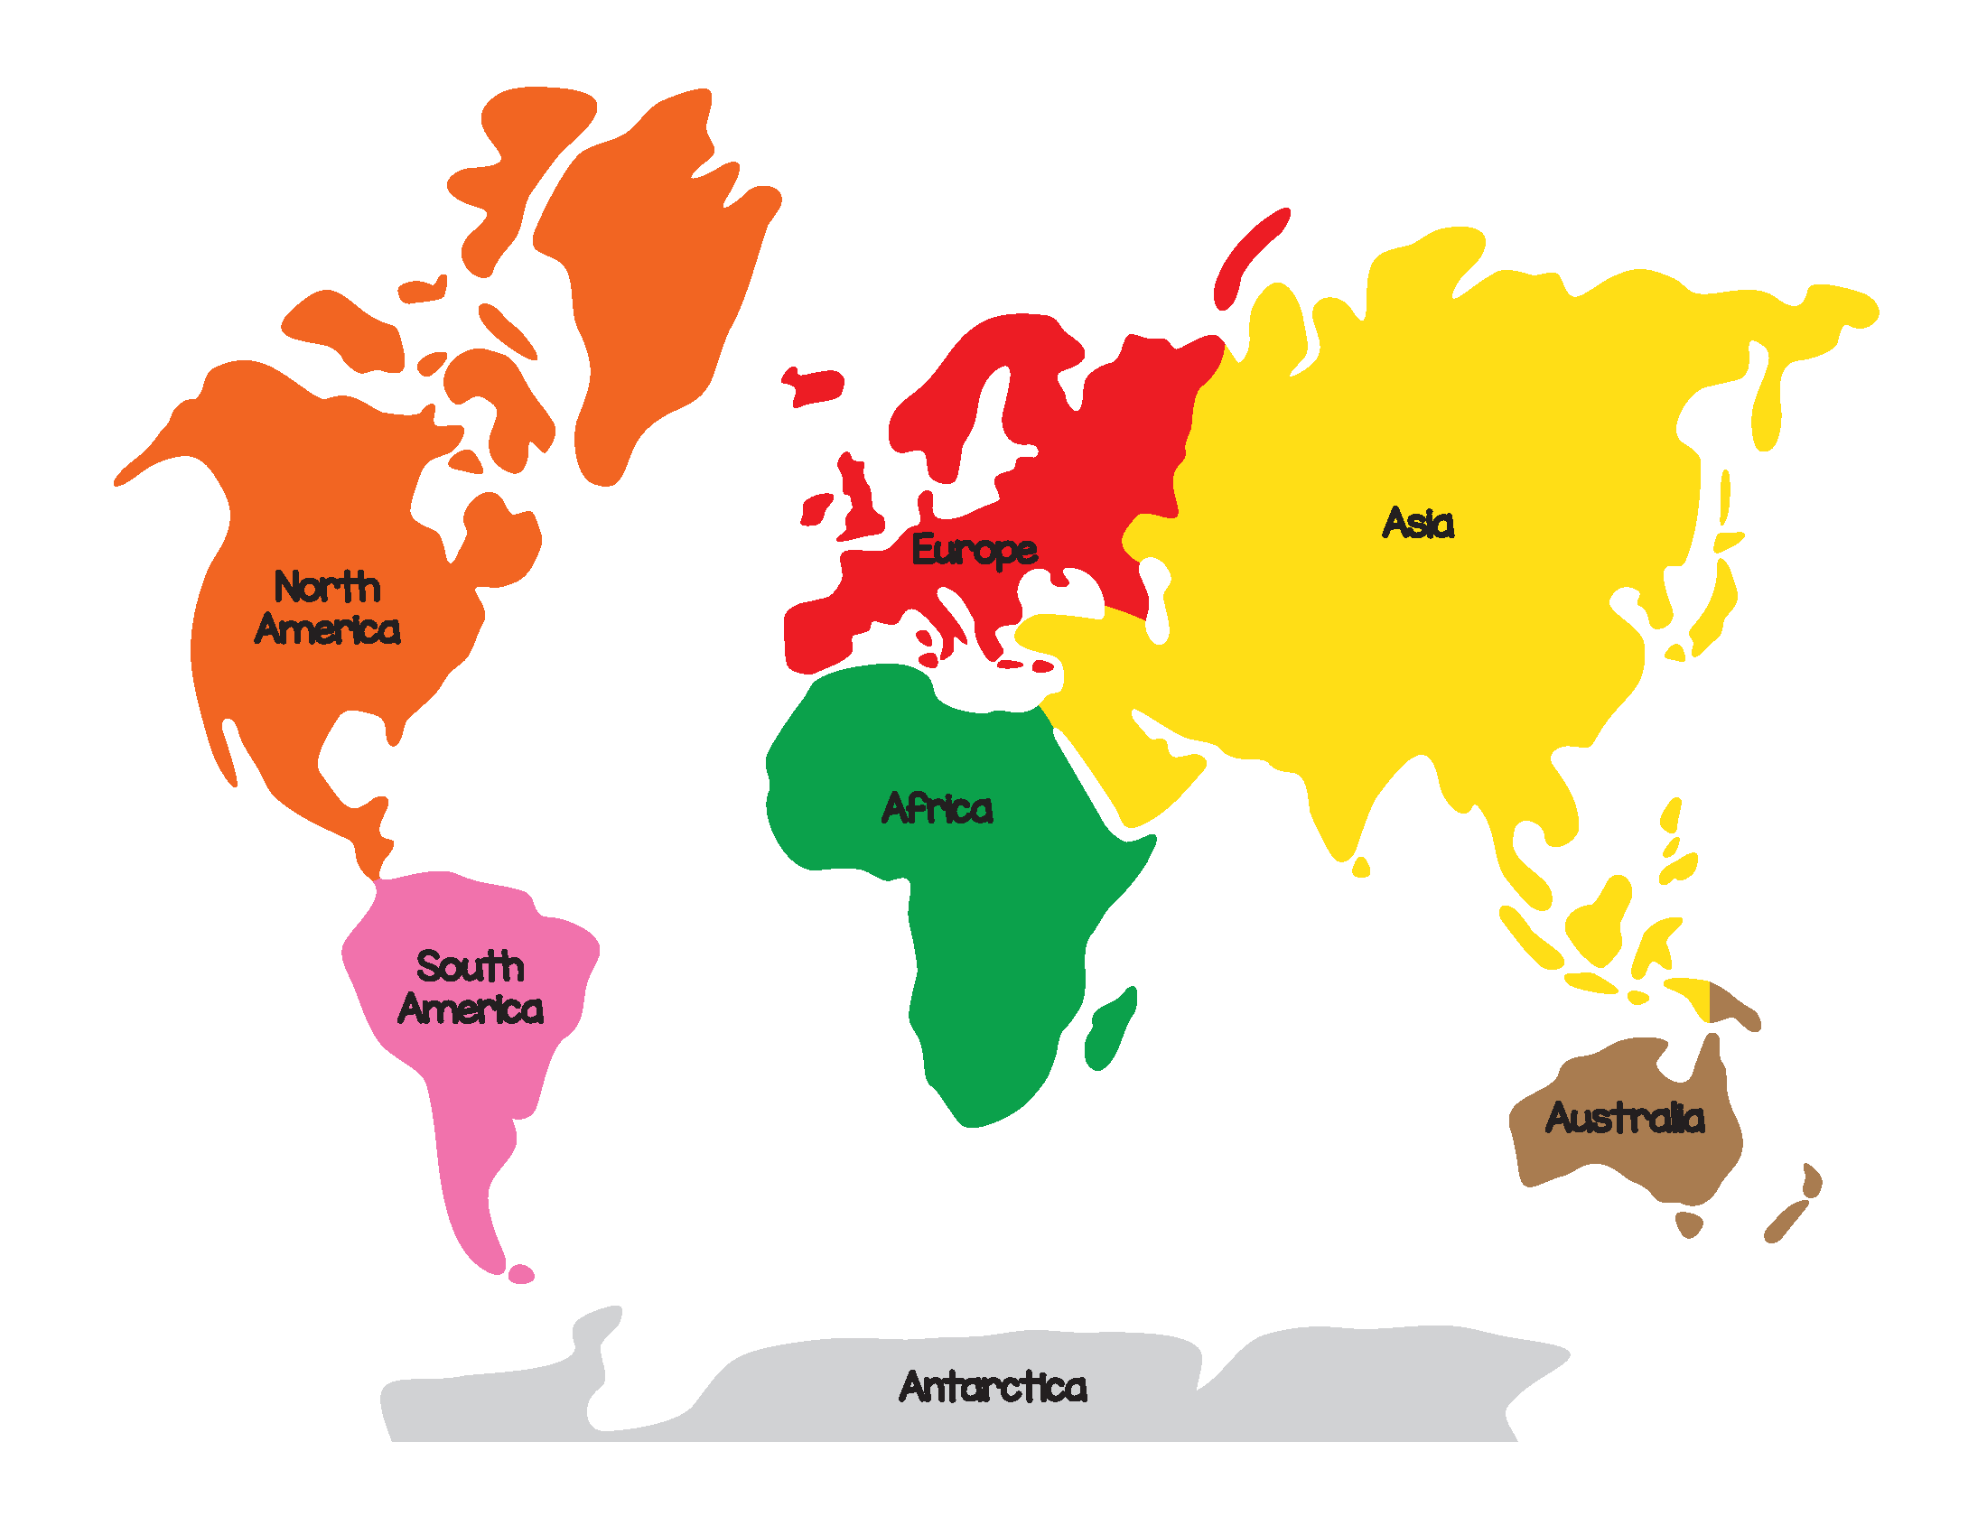
9%
0.7%
2%
<1%
2%
7%
2%
3.2%
0%
<5%
<2%
2.2%
0%
Notes:
SPB 2mins
When we talk about men in the early years, assertions that the profession is ‘an almost entirely gendered career’ (Penn and McQuail, 1997, p.iv) would be a bit of an understatement; in fact, to say that a man in the Early Years is ‘gold dust’ is far from an exaggeration. In the UK, the percentages fluctuate between 2-3% and the evidence shows that this is not a contemporary issue pertaining just to the UK – this is a global issue.
Discuss the different percentages – ‘almost no male workers’ in Poland all the way up to 9% in Norway. Brody (2015) points out that the general pattern in the world as a whole is that less than 3 per cent of pre-school educators are male.
Joke: Unsurprisingly, there are no men in the early years in Antarctica [final click]!

Slide 4
Attracting
Recruiting
Retaining
Developing
Schools and settings
Government – local/ national
Training providers
Men’s Groups
Notes:
DW 3.5mins
So…what can be done about this? Most of the literature asserts that it is a recruitment issue but Simon and I argue that there are actually four key areas that need to be focussed on – these are attracting, recruiting, retaining and developing men [click]. Talk about how we need to get their [men's] attention (like a magpie with something shiny), get them into the training classroom or ‘over the doorstep’ (recruit), keep them there (make them want to stay – retain) and help them to grow (in a professional sense – develop).
We also argue that there are some ‘key players’ who can help to support this massive undertaking, examples of which include [click] schools and settings, government – local national, Men’s Groups (like the BMIEYN (Simon) and the SAMEYN (David)) and training providers (FE/HE).
The abstract for this workshop said that ‘delegates will have the opportunity to build a metaphorical ‘toolkit’ of ideas that they can take back to their workplace and put into action in an effort to inspire men to want to work with young children!’ So let’s have a look at the government and explore what they could do to ‘ARRD’ men in the Early Years!

Slide 5

Government publications
Meeting the Childcare Challenge (Green Paper) (DfEE, DSS and Ministers for Women, 1998)
EYDCP Planning Guidance 2001-2002 (DfES, 2001)
Children’s Workforce Strategy (DfES, 2005)
Supporting Families in the Foundation Years (DfE and DoH, 2011)
Early Years Workforce Strategy (DfE, 2017)
Notes:
SPB 1.5mins
Burgess (in Morton, 2015) asserts that ‘[g]overnments have been talking about wanting to improve male representation in the early years workforce for many years now’. Indeed, if we shine a spotlight on the British government, we can see how men who work with young children (or who do not work with them as is unfortunately the case!) have been ‘on their radar’ for quite a while now [click].
In these different documents mention is given to ‘men as role models’, ‘increasing the number of men in the sector’, and ‘addressing the gender imbalance’.

Slide 6

Cause for celebration?
Bartlett (2015, p.3) is quick to remind us that ‘government targets and initiatives have come and gone without making significant inroads into the gender imbalance in the childcare workforce … while the political will may be there in the background, up to now this has not been translated into real, tangible improvements’.
Notes:
DW 1.5mins
But is this a cause for celebration? Well, Simon and I would personally would not pop the champagne corks quite yet, especially when you take into consideration the writing of Bartlett (2015) who is quick to remind us that… [see slide].
So, this begs the question ‘what could the government do to assure some affirmative action?’

Slide 7
Large scale “longitudinal research” to explore the “long term” impact of men in the Early Years sector at a “broad” [national] level (Interviewee 1)
A careful review of pay and conditions in the Early Years sector to recognise the “seriousness of the job” (Interviewee 2)
Compulsory national “gender training” to help raise awareness to the very real difficulties men (and women) face in the Early Years sector (Interviewee 3)
Notes:
SPB 2.5mins
Well, findings from the research I undertook for the co-authored book that David and I had published this year yielded six key strategies.
NOTE: Simon to briefly talk about the first three strategies; David to discuss the next three strategies (see the next slide).
Discuss as appropriate.

Slide 8
A national Men-in-Early-Years advocate who is rooted in both policy and practice should be identified as a dedicated “Early Years Education Minister” (Interviewees 1 and 3)
A promise should be made to raise the “low status” and profile/‘prestige’ of the Early Years (Interviewee 3)
“Advertising or good PR” should be utilised to “make the Early Years cool/attractive” and ensure that the more-men-in-Early-Years agenda is “not forgotten” (Interviewee 1)
Notes:
DW 2.5mins
David to talk briefly about these three strategies.

Slide 9

Activity
Think, Pair, Share & Compare!
    Training providers
    Schools and settings
    Men’s Groups
Notes:
SPB 4mins+15mins
Now, rather than this being ‘The Simon and David Show’, it is important that you have the chance to think about how we can ‘ARRD men’ in the Early Years. We are going to do this using an inter-activity called ‘Think, Pair, Share and Compare’!
TASK: Get delegates to turn to the coloured paper sheet that is in front of them/has been handed out to them. The colour indicates one of the three ‘key players’ that I want them to focus on. Their task is to first think on their own about how TP/S&S/MGs could help with the ARRD of men in the Early Years; then they need to pair up with someone with the same coloured sheet in the room to see what each other has got (add to their sheet) and then they are to share their ideas with people with other coloured sheets (adding ideas to their sheet). Once complete, give out or signpost them to the ‘Strategies Handout’ for them to compare with suggestions from Chapter 7.
SPB and DW to circulate and support as and where necessary.
Bring together – useful? Any questions, comments or any strategies, ideas or suggestions that have not been considered?

Slide 10

Conclusions
Strategies, approaches, ideas & suggestions have the potential for ‘real impact’ if/when utilised
‘Different contexts, situations and expectations’ (Brownhill, 2015, p.210) can influence the success or failure of implemented ideas
Honig (2008, p.676) suggests that ‘recruiting techniques require creativity and ingenuity to enlist men into participation in early childhood settings’
Notes:
SPB 3mins
So, let’s bring the session to a close by drawing together some key conclusions. Discuss as appropriate:
Stress the idea of ‘potential’ – it is only when you have put them into practice that you will know if they work or not – if they don’t work, what could be done to make them work?
C/S/E can have a positive or negative impact on the outcomes of the ideas that are put into practice. REMEMBER: ‘Our fundamental aim is not just about attracting, recruiting, retaining and developing a greater quantity of men in the Early Years sector; it is also about raising the quality of those who are attracted, recruited, retained and developed. The idea that ‘any bloke will do’ is simply unacceptable – we believe that young children will not flourish and succeed in their formative years if they are not supported by the best practitioners performing the best practice.’
If we want to increase the number of men in the sector we need to take Honig’s advice from a decade ago and think of creative and ingenious ways to get men into the early years, examples of which include social media, videos, personalised text messages, radio adverts, roadshows and stickers on items that men purchase, e.g. deodorant, tools.

Slide 11
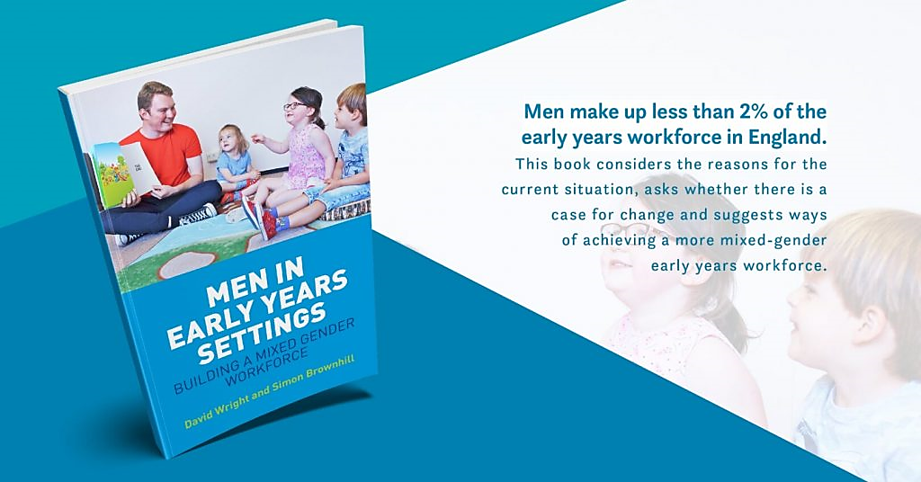

Notes:
DW 2mins
If you are interested in wanting to know more about men in the Early Years then do consider investing in a copy of our co-authored book, of which we have inspection copies and flyers available. Simon and I are looking to retire off the royalties, so we need to shift a fair few in the next six minutes!
We hope you found the session useful and that you can put at least one thing in place that has a positive effect on your return to your work context.
Many thanks.
Q and A as appropriate.

