Slide 1


Slide 2
The important bits
Toilets:
Basement - Including Disabled and Baby Changing Facilities
2nd Floor - Ladies adjacent to the staircase/fire exit
3rd Floor - Men’s adjacent to the staircase/fire exit
Disabled next to Hill room
The main staircase runs from the basement, past the Ground Floor to the 1st Floor. To continue on to the 3rd floor, follow the corridor past the hall, and then past the lift. Go through fire door by the lift and then sharp right to go through a second fire door, which will bring you onto a staircase/fire exit. This staircase will take you to the 3rd floor.

Slide 3
The important bits
The fire alarm is a continuous ringing bell. It is directly linked to the Fire Service. If you hear it ring it is a real emergency and you should follow the following instructions.
If you discover a fire, please operate the nearest red fire alarm point immediately. The alarm points are located in every meeting room and corridor, and on every staircase.
Please leave the building using the nearest fire escape route, as indicated by the green emergency exit signs.
Workshop people: to have furniture moved etc, call 2020
SSID: AbbeyConference
Password: Abb3yc0nf1234$
Hashtag: #MITEY2019

Slide 4


Slide 5
1998: 2%
2008: 2%
2018: 3%

Slide 6
Notes:
Hospital doctors:
NHS Digital (2018) Narrowing of NHS gender divide but men still the majority in senior roles. NHS Digital, 8 March 2018
https://digital.nhs.uk/news-and-events/latest-news/narrowing-of-nhs-gender-divide-but-men-still-the-majority-in-senior-roles
GPs:
Bostock, N (2018) The rise of women in general practice, GP Online, 8 March 2018 https://www.gponline.com/rise-women-general-practice/article/1458988
Teaching:
Sellgren, K. (2016) Classrooms need more male teachers, charity says. BBC News online, 5 October 2016
https://www.bbc.com/news/education-37552056
Social work:
Department for Education Experimental statistics: Children and family social
work workforce in England, year ending 30 September 2017
SFR 09/2018, 15 February 2018
https://assets.publishing.service.gov.uk/government/uploads/system/uploads/attachment_data/file/681546/SFR09-2018_Main_Text.pdf
Nursing:
Nursing and Midwifery Council Register Data Report March 2019.
https://www.nmc.org.uk/globalassets/sitedocuments/other-publications/nmc-register-data-march-19.pdf
Early years:
DFE Survey of Childcare and Early Years Providers 2018
https://assets.publishing.service.gov.uk/government/uploads/system/uploads/attachment_data/file/795332/Frontier_-_SCEYP_2018_Finance_Report_v2.pdf See footnote on p29

Slide 7
The bigger picture
Many countries, including Germany, France and the UK, face a shortage of skilled staff in Early Childhood Education and Care. Children’s participation in ECEC is growing in almost all OECD countries but the supply of highly skilled and highly qualified workers is struggling to keep up.
Factors in this gap include:
  Ageing workforce
  Lack of skilled/qualified new entrants
  High turnover/poor retention
  Overwhelmingly female workforce
(Source: OECD 2019)

Slide 8
And why it matters…
“The limited number of men in ECEC has implications for child development, particularly in relation to the development of attitudes towards gender roles.
On a staffing level, it also reduces the pool of available workers.”
Source: OECD, 2019

Slide 9
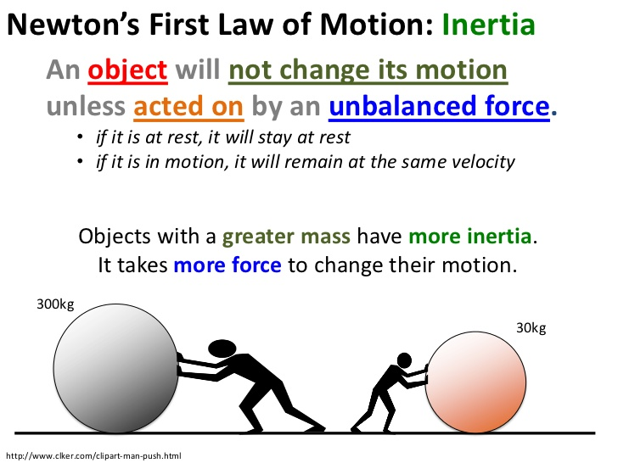
Why MITEY?

Slide 10
We have a total budget of £30k from DfE to produce these things:
Today’s conference
Resources at miteyuk.org, all before March 2020:
For potential recruits: case studies, guide to training options
For employers: case studies, guide to recruitment, guide to communicating with parents, the MITEY Charter & Mythbuster: 10 myths about men and early years education …and how to bust them
For everyone: Jobs board; online support sessions (Oct to Mar)
For careers advisers: guide to supporting males into early years

Slide 11
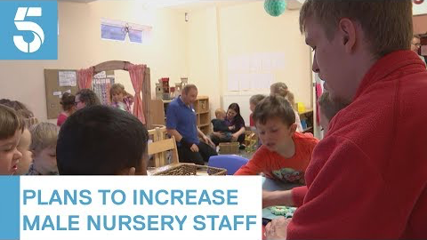
We have no budget for publicity but we are doing our best to get positive messages out to the media

Slide 12
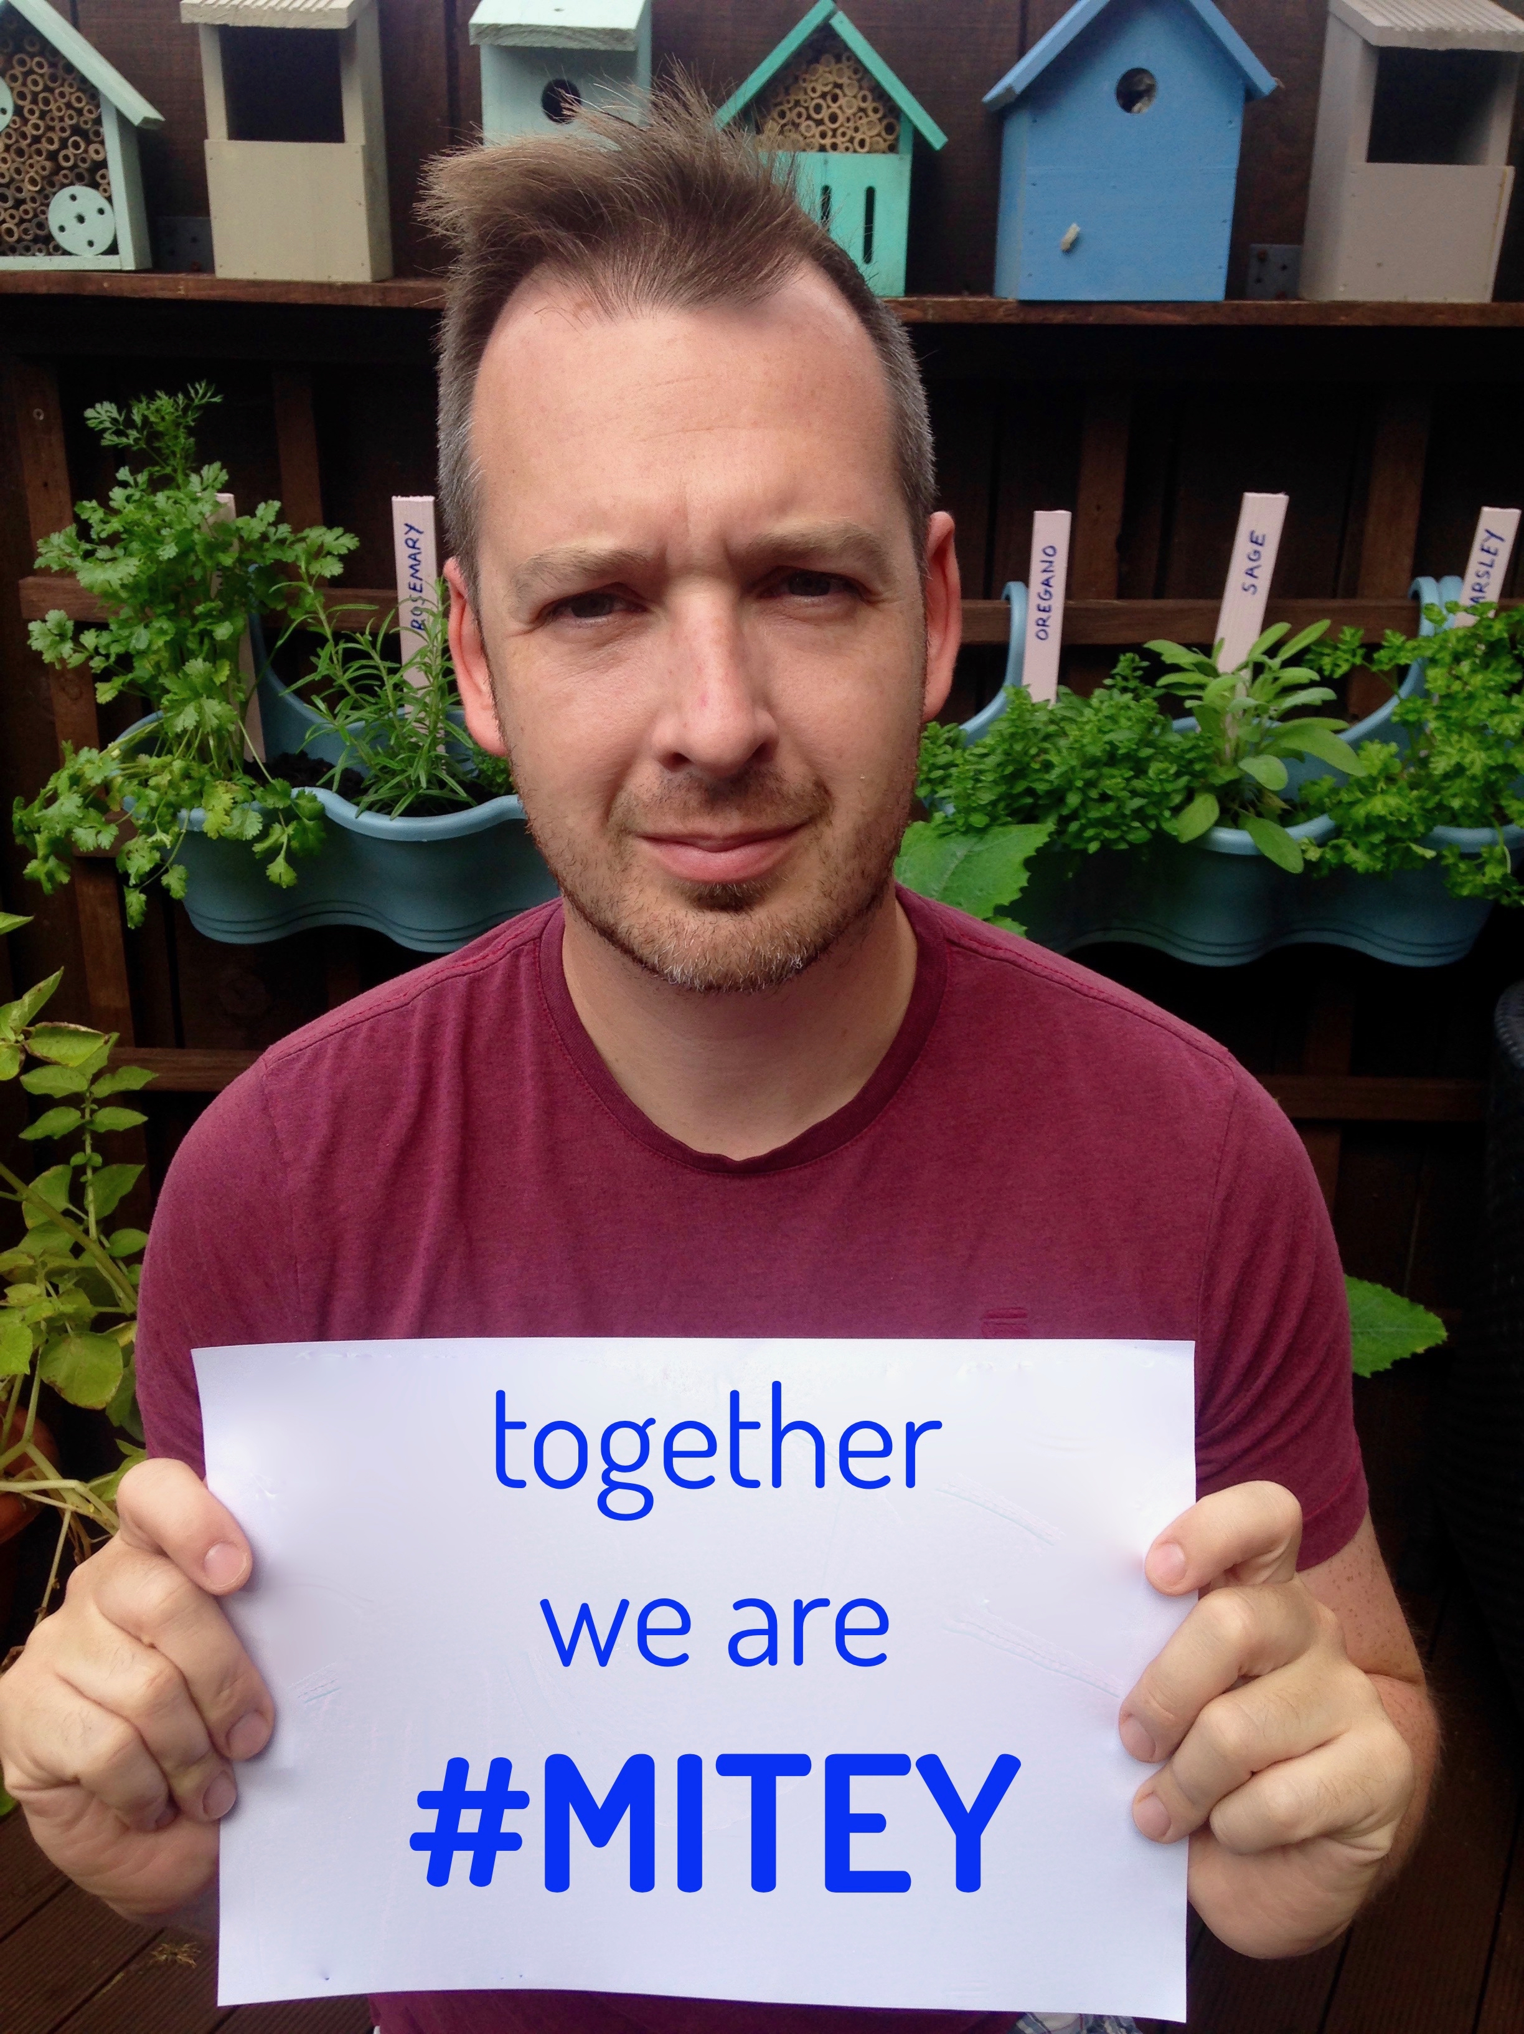
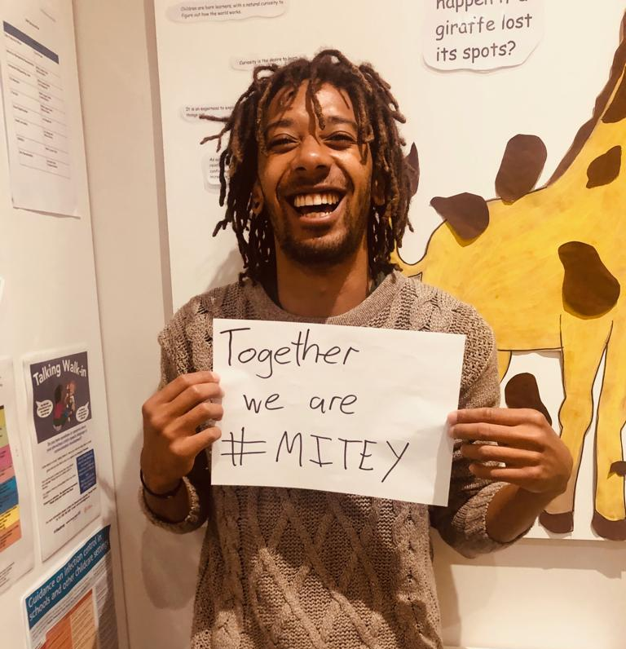
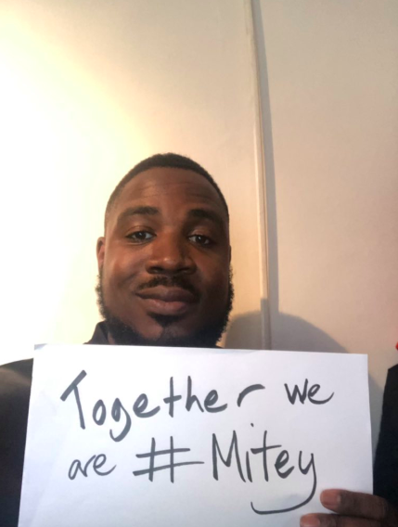
We are building a community for
MITEY men – and gender diversity advocates

Slide 13
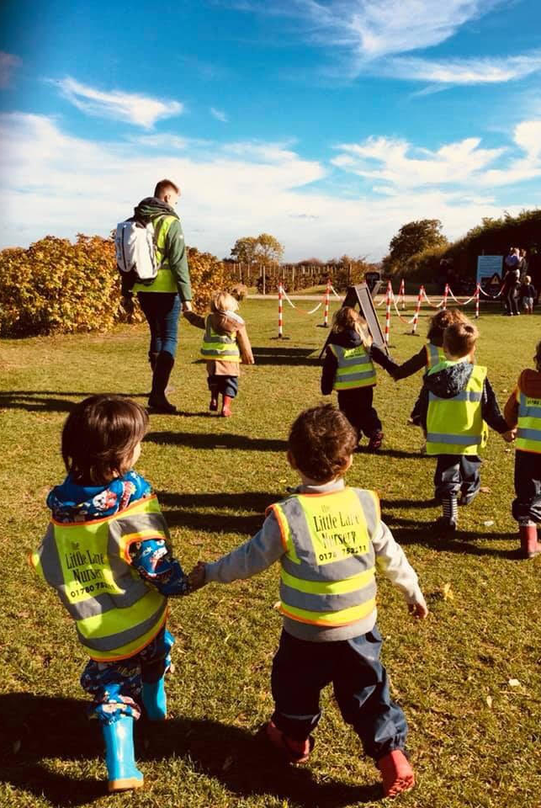
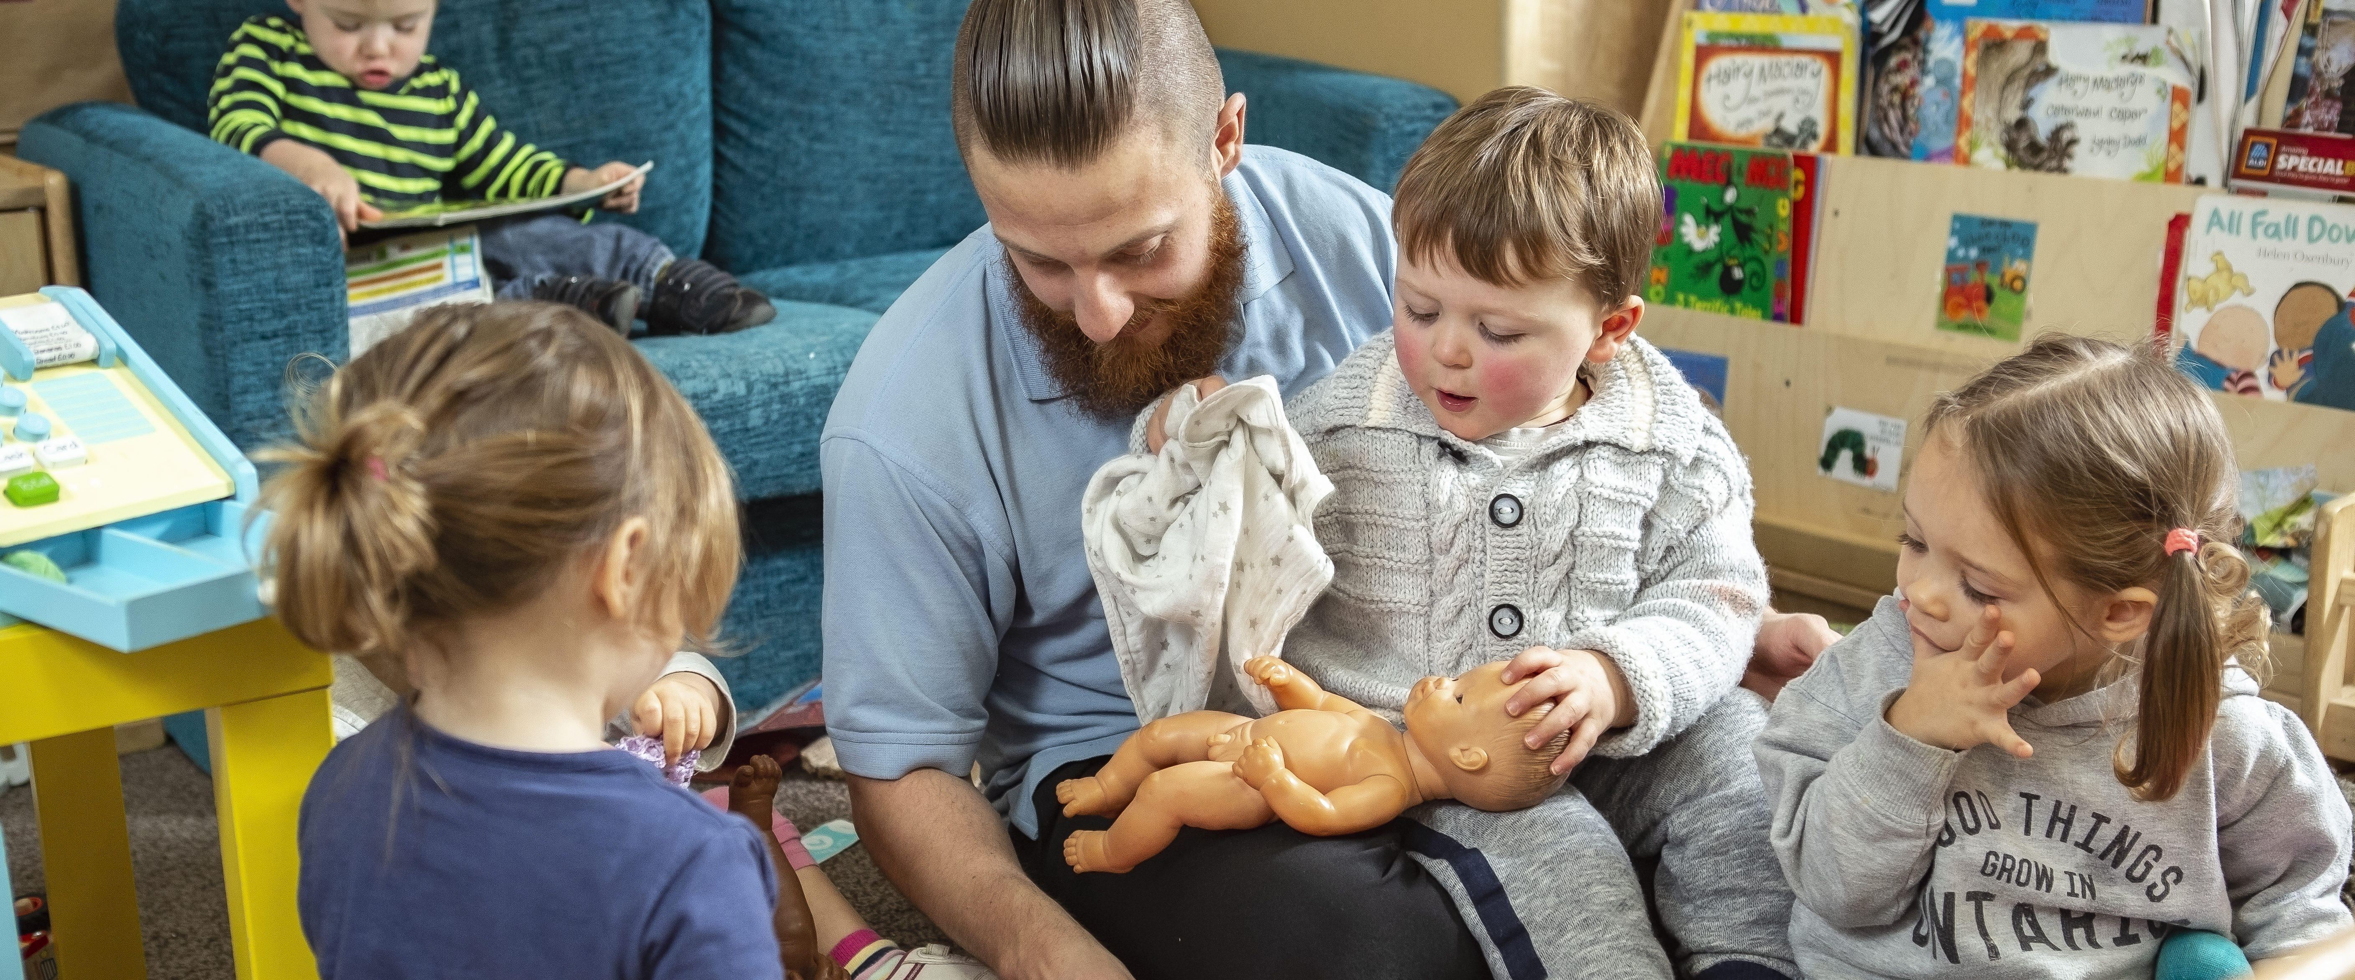
We have a strong vision of what the future should look like

Slide 14
Our message is clear
We need a high quality and gender-diverse Early Years workforce:
To show children that we can all be caregivers/ educators
To reflect and engage with the community we serve
To give more men the chance to take part in this amazing work
To ensure that children are looked after and educated by the best possible professionals, unlimited by gender

Slide 15
Doing what we’re doing is NOT WORKING
We need to change the narrative
We need to change the infrastructure
We need to bang heads together
We need to try new approaches and evaluate them
We need to share best practice and support each other
We need to tell our stories

Slide 16
What needs to happen – long term (by 2024)
High profile publicity campaign to improve parents’ understanding of need for diverse staff delivering high quality education/care
National MITEY careers campaign including TV/radio/billboard advertising
High quality research into gender-diverse EY workforces (how to create them, how they function, impact on teams and on children)

Slide 17
What needs to happen – medium term (2022 onwards)
Clear training and career pathways for different groups of boys/men and positive action strategies agreed by training providers
National gender equality audit of careers advice services (schools-based & adult) and MITEY resource pack
Sustained action by Early Years employers to recruit male staff, supported by MITEY resources and network

Slide 18
What needs to happen – short term (2020-22)
High quality annual reporting on Early Years workforce by gender, age, ethnicity
Nationally coordinated gender awareness training for EY employers & staff teams
Legislation/guidance to end gender-discriminatory policies on intimate care in Early Years; resources/ training for managers on dealing with parental concerns; and nationally coordinated support for MITEY men in such situations
Programme of ‘learning events’ (face-to-face and virtual) for sharing best practice
Nationally coordinated MITEY policy advice, lobbying and communications

Slide 19
What YOU can do TODAY
Commit to change. On a Post-it note tell us ONE ACTION you are going to take.
Tell us what needs to happen. On another Post-it note tell us ONE THING you’d like the MITEY campaign to do.
If you’re on Twitter, follow us @MITEYUK and tweet about today using #MITEY2019.
And keep the TOGETHER WE ARE #MITEY selfies coming!

Slide 20
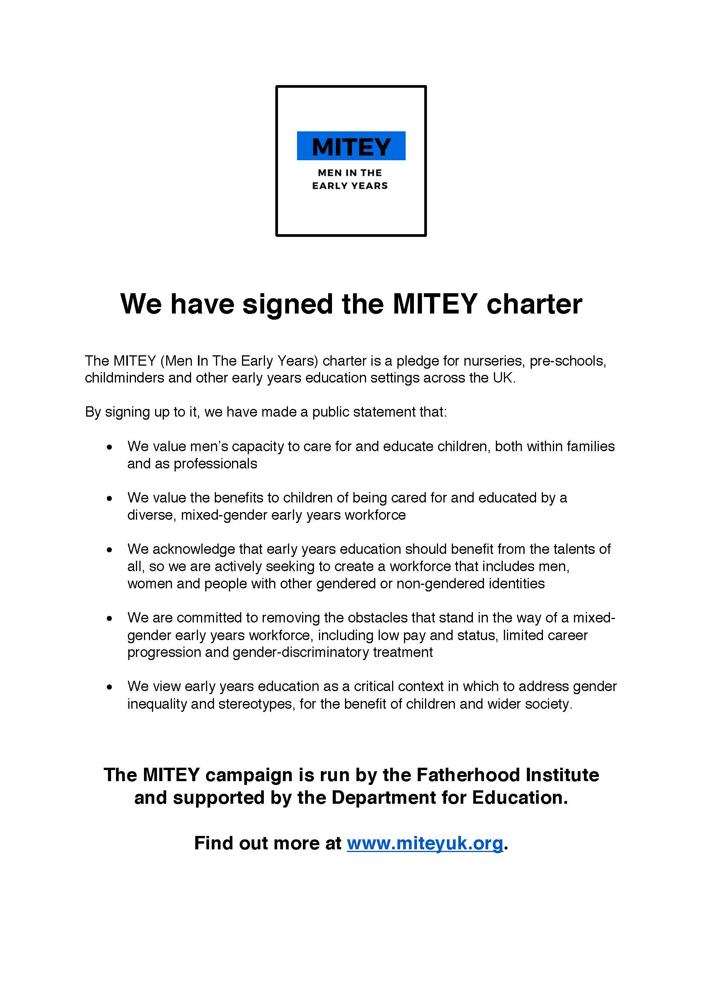
What you can do next: the MITEY Charter
We value men’s capacity to care for and educate children, both within families and as professionals
We value the benefits to children of being cared for and educated by a diverse, mixed-gender early years workforce
We acknowledge that early years education should benefit from the talents of all, so we are actively seeking to create a workforce that includes men, women and people with other gendered or non-gendered identities
We are committed to removing the obstacles that stand in the way of a mixed-gender early years workforce, including low pay and status, limited career progression and gender-discriminatory treatment
We view early years education as a critical context in which to address gender inequality and stereotypes, for the benefit of children and wider society.

Slide 21
What you can do next
Join the campaign
Sign up to the Charter, display it PROUDLY in your setting AND put it on your website – and use it to open up a discussion with staff and parents
Help us shape the campaign post March 2020 – contribute to our consultation, online now.
Now please go to Facebook Fatherhood Institute to watch the next session live: ADD A ❤ and SHARE with as many people as possible!

Slide 22
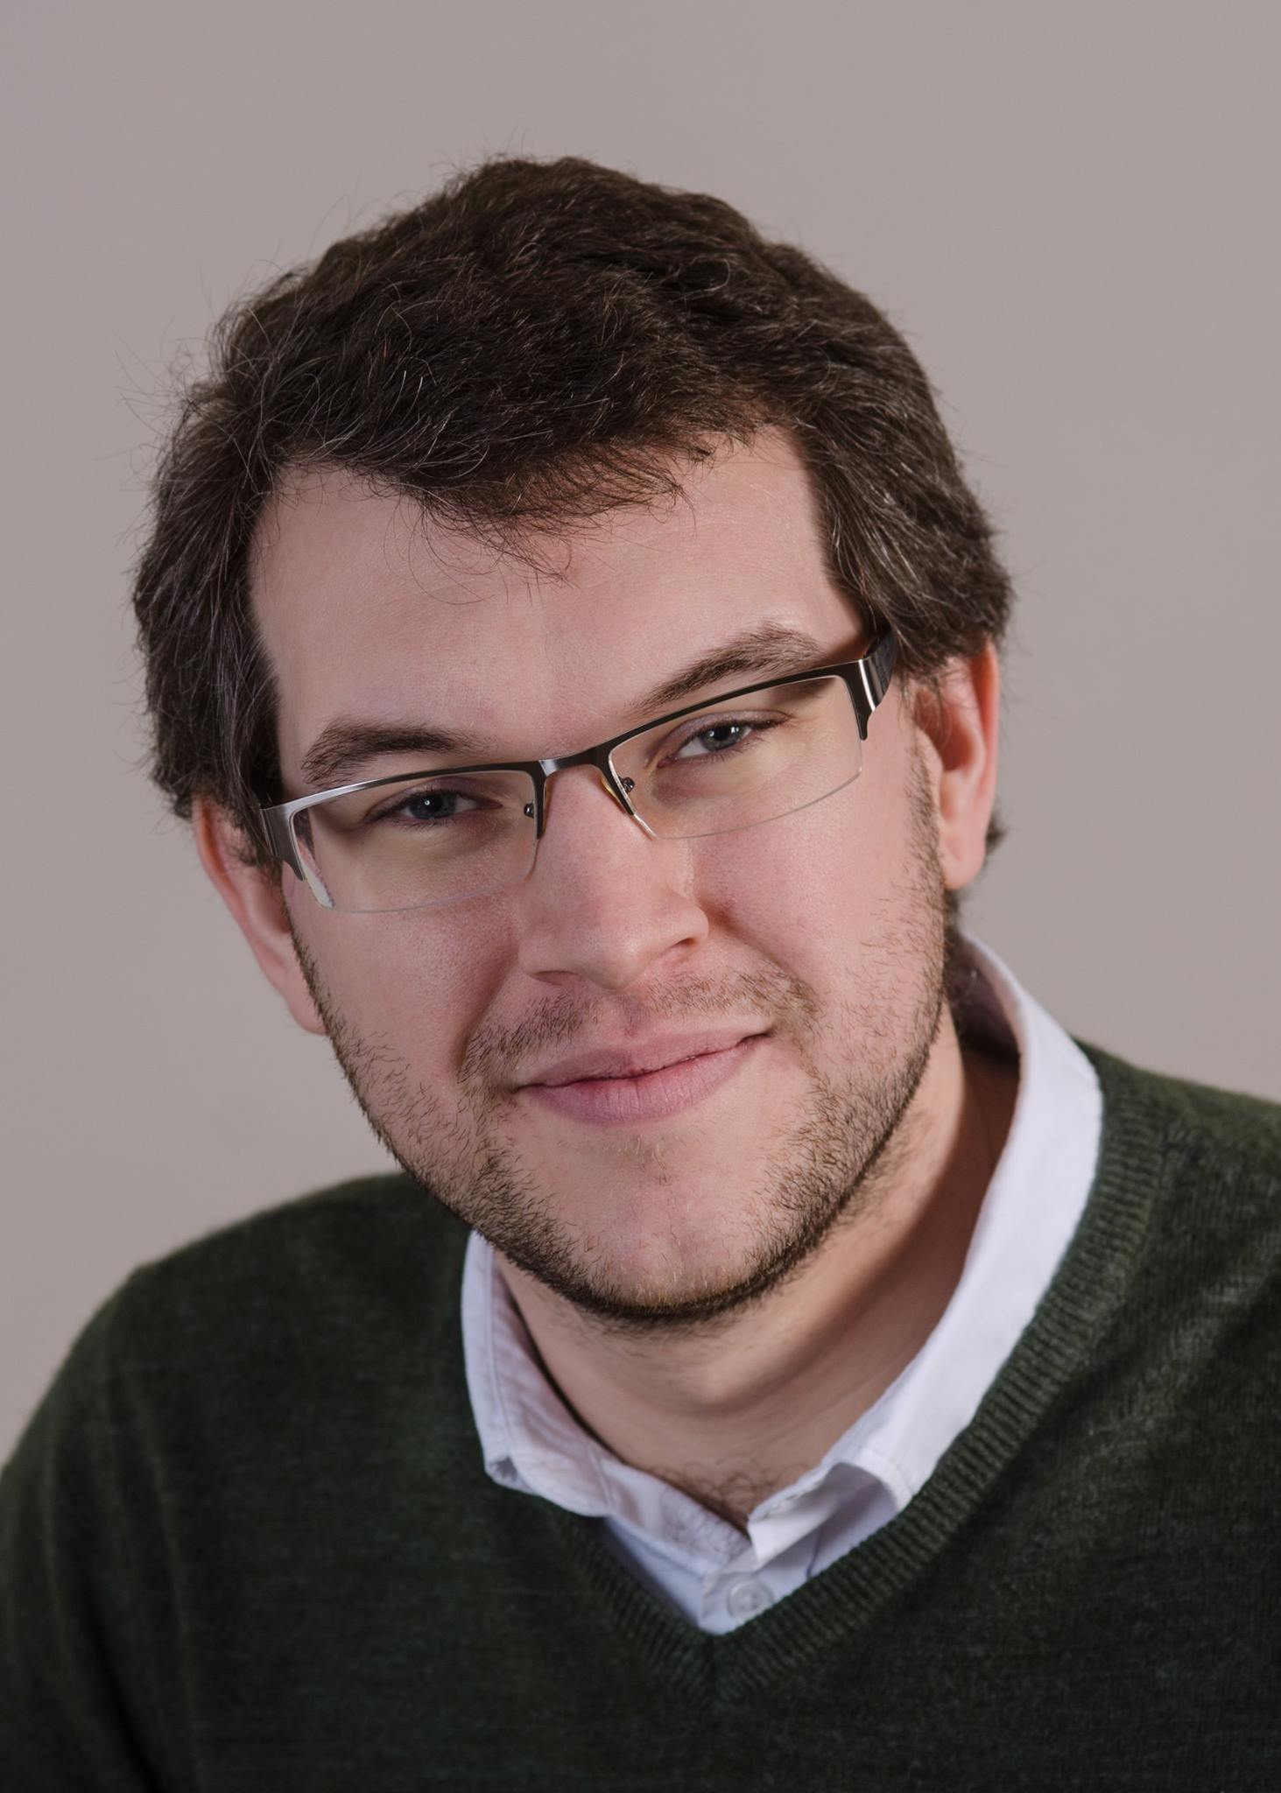
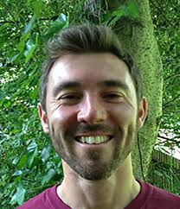
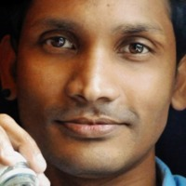
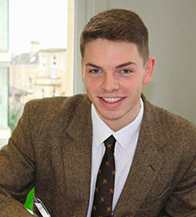
Minority Report: Tales from the 3%
Jamel Carly, freelance early years educator from South London
Luke Jeffery, deputy nursery manager at an independent school in Bath
Matt Burden, forest school nursery manager from Sheffield
Sid Mohandas, Montessori practitioner/ PhD student from London
Charles Lanzani, one of the first ever male Norland nannies
Interviewer: Jack O’Sullivan, Fatherhood Institute trustee #MITEY2019

Slide 23
#MITEY2019
Susie Owen, Deputy Director of Early Years
Department of Education

