Slide 1

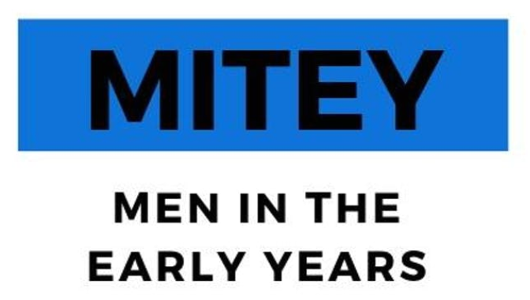
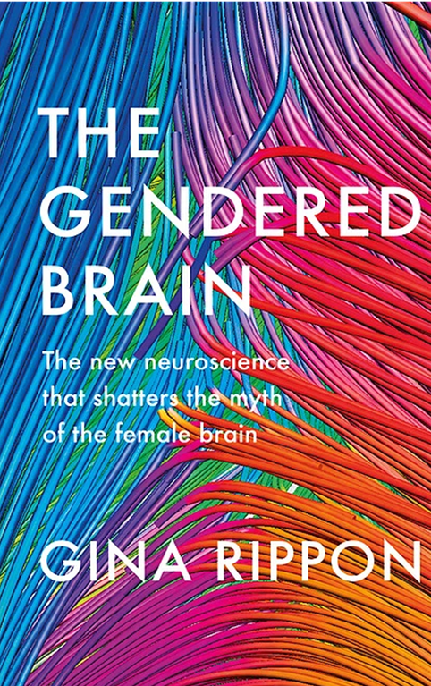

“Mind the Gender Gap:
Why men aren’t from Mars and women aren’t from Venus – and what that means for early years education”
Professor Gina Rippon,
Aston Brain Centre, Aston University.

Slide 2
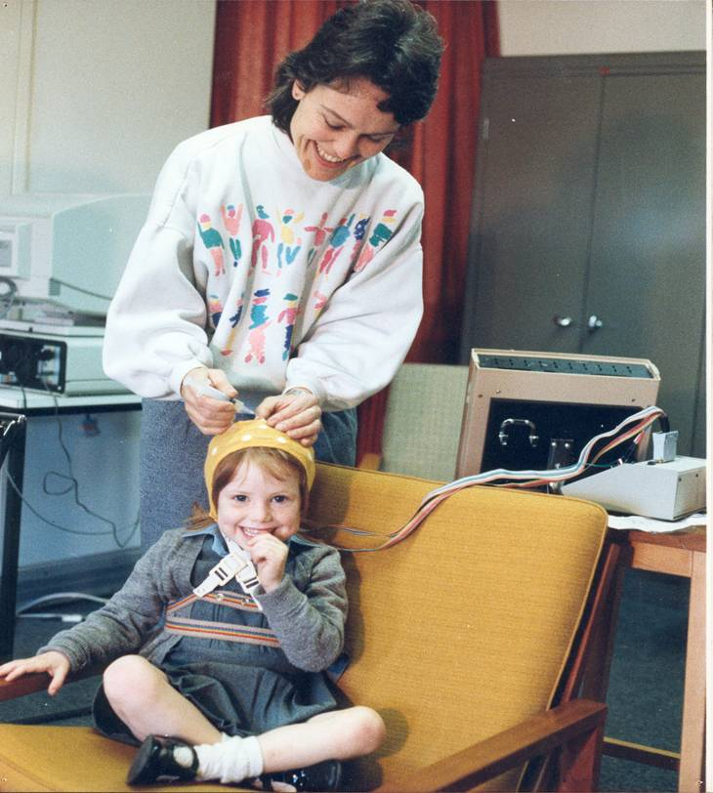
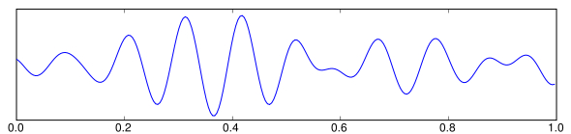
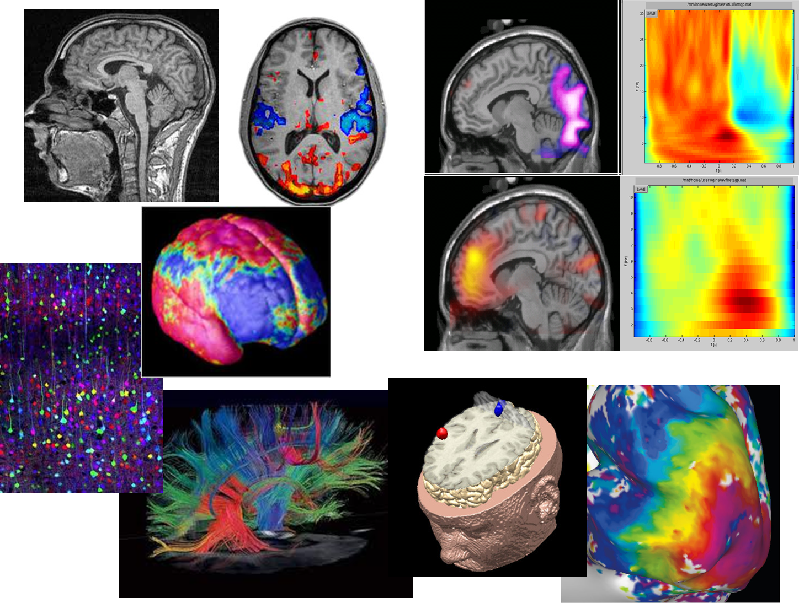
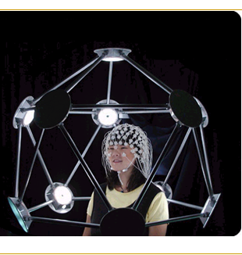

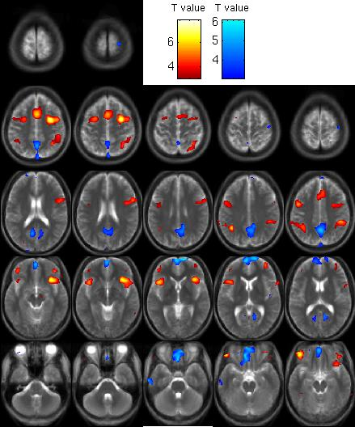
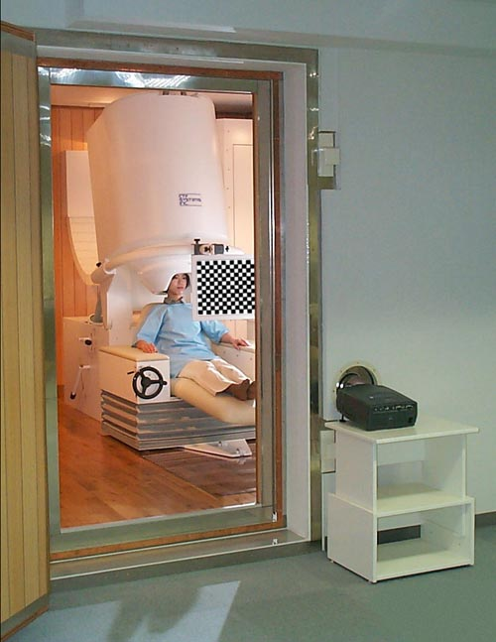
Aston Brain Centre
ELECTROENCEPHALOGRAPHY [EEG]
MAGNETO-ENCEPHALOGRAPHY
[MEG]
FUNCTIONAL
MAGNETIC RESONANCE IMAGING
[fMRI]

Slide 3
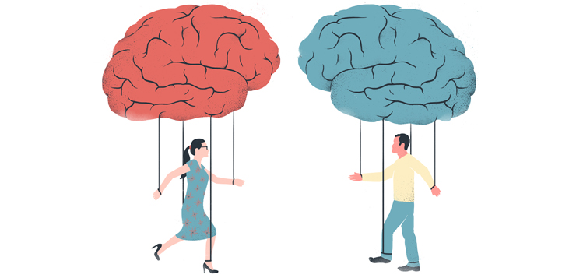
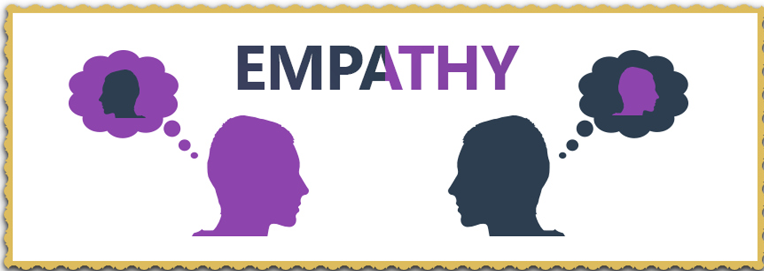

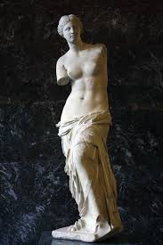


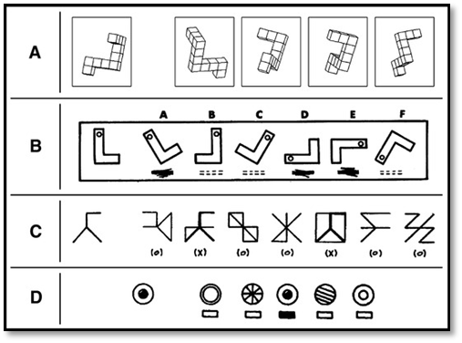
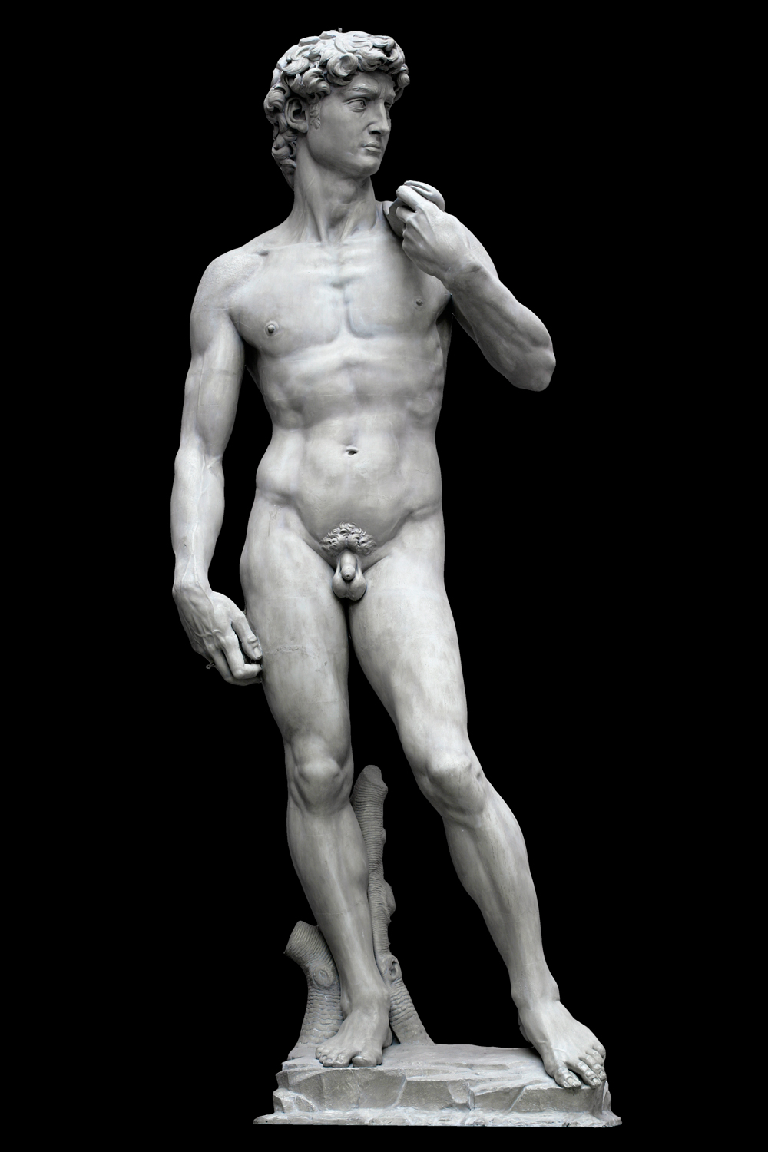

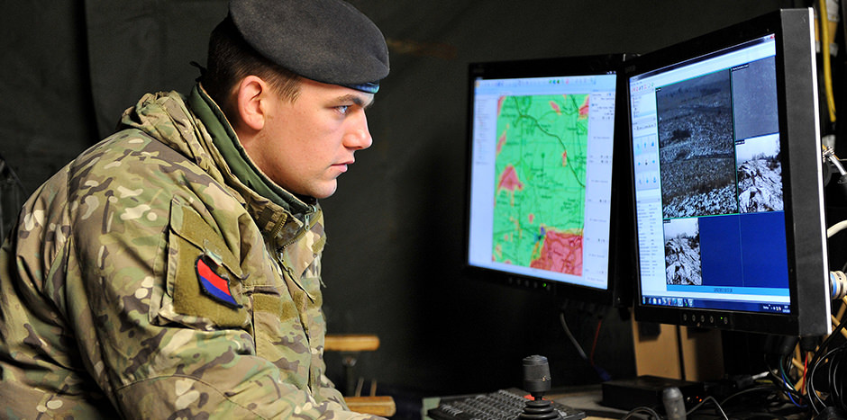


Two types of body = two types of brain = two types of skillsets = two types of social roles

Slide 4
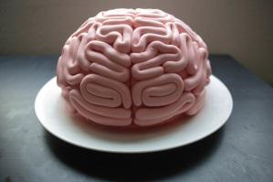

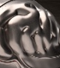
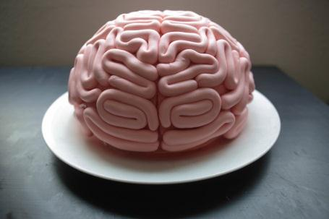
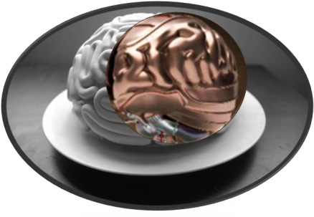
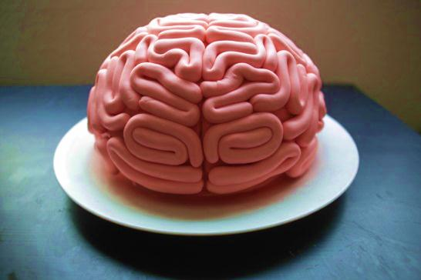
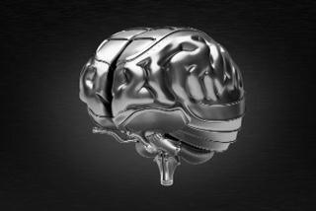
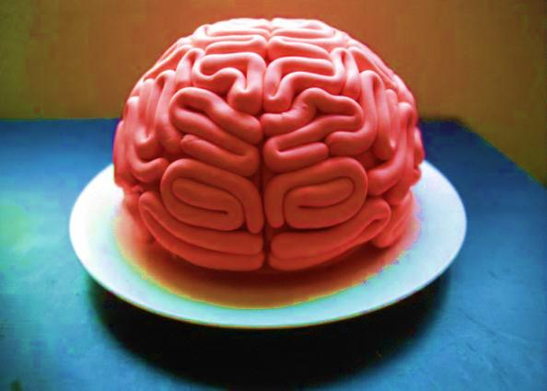
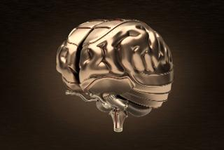


The ‘essentialist’ story: brain development as a one-way street; fixed, inevitable, invariant.

Slide 5

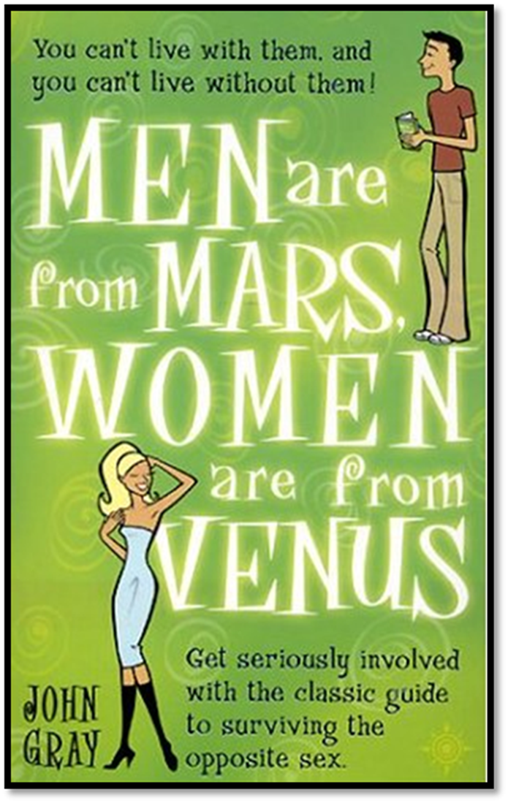
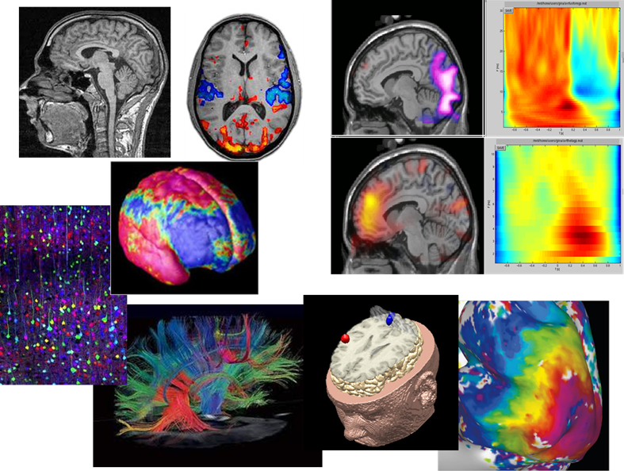
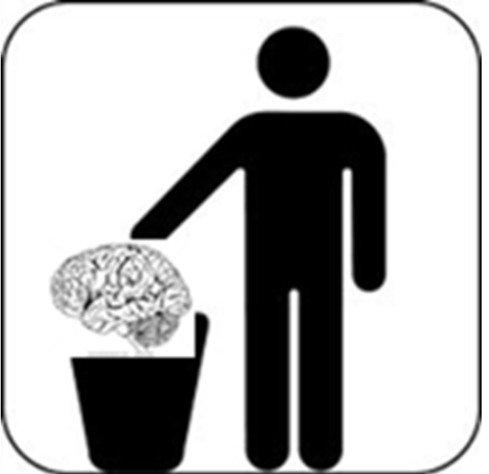


1990s- Brain Imaging arrives. The Invisible made Visible?
NEUROTRASH

Slide 6
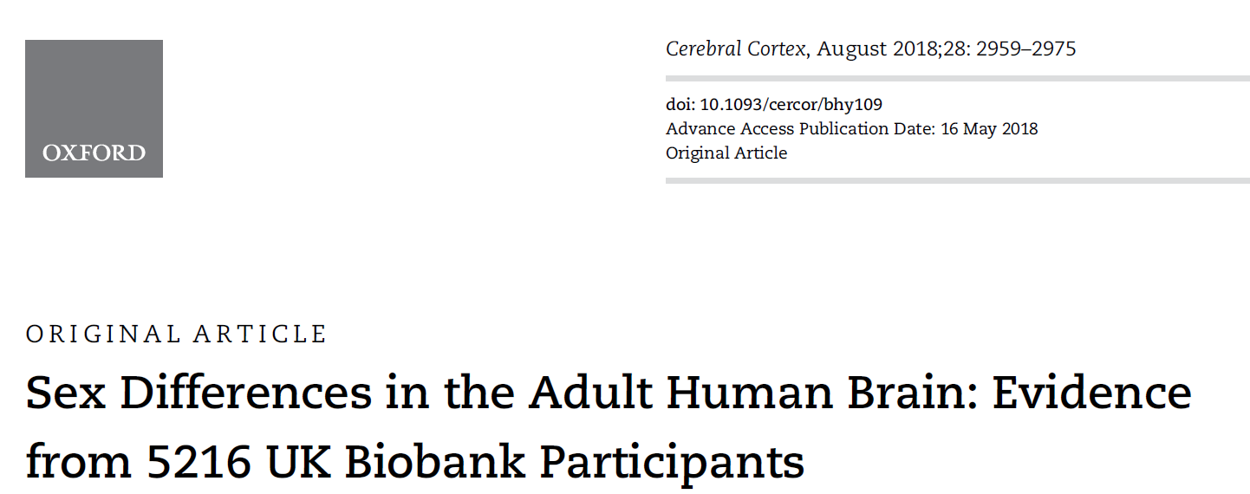
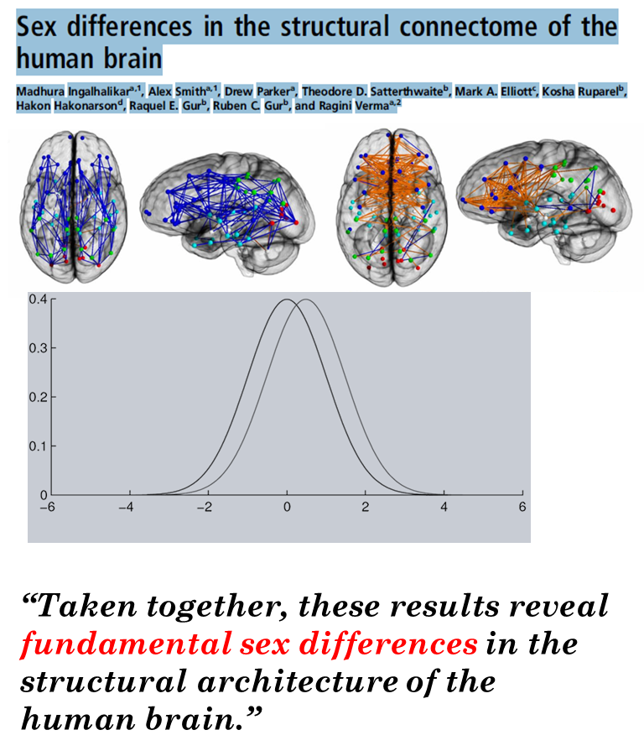
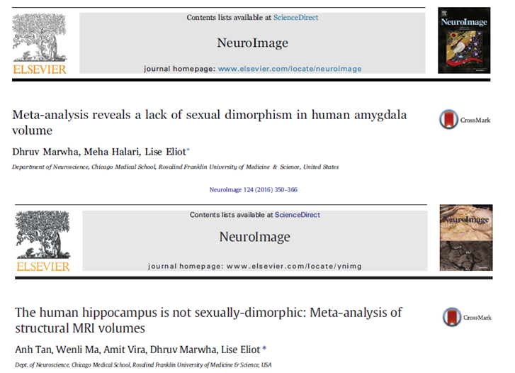
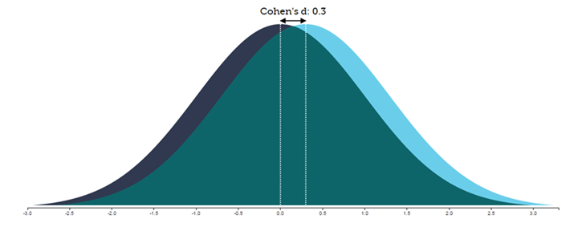
Sex differences in the brain?
When is a difference not a difference?

Slide 7
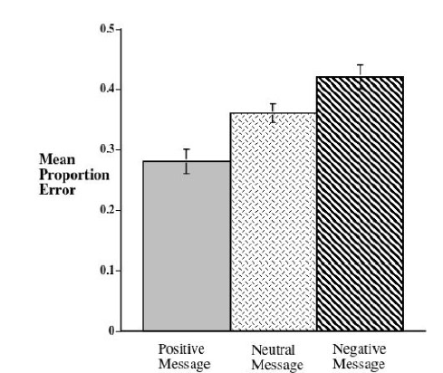
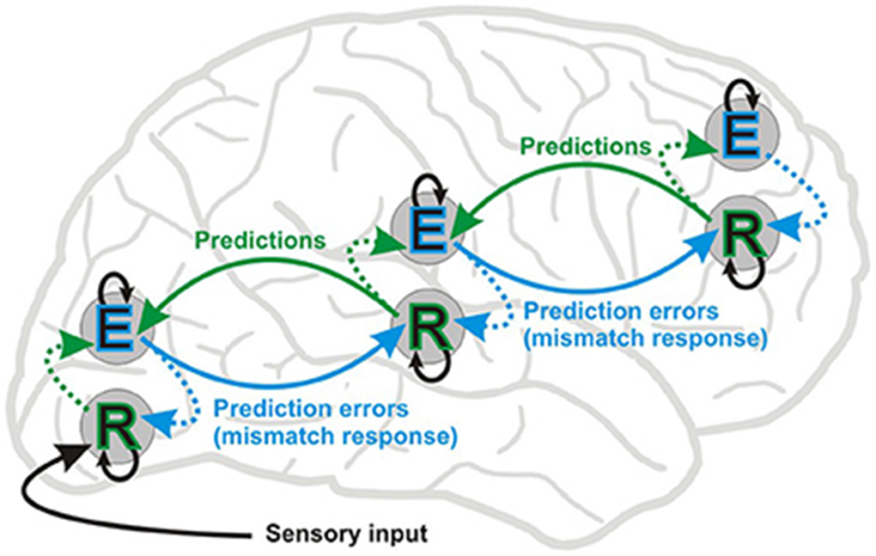
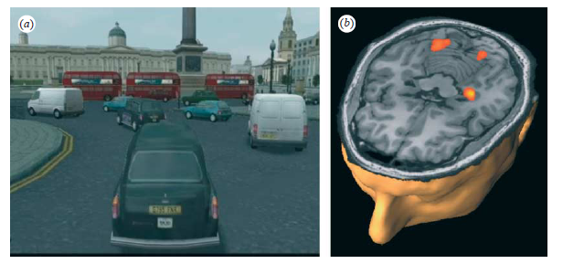

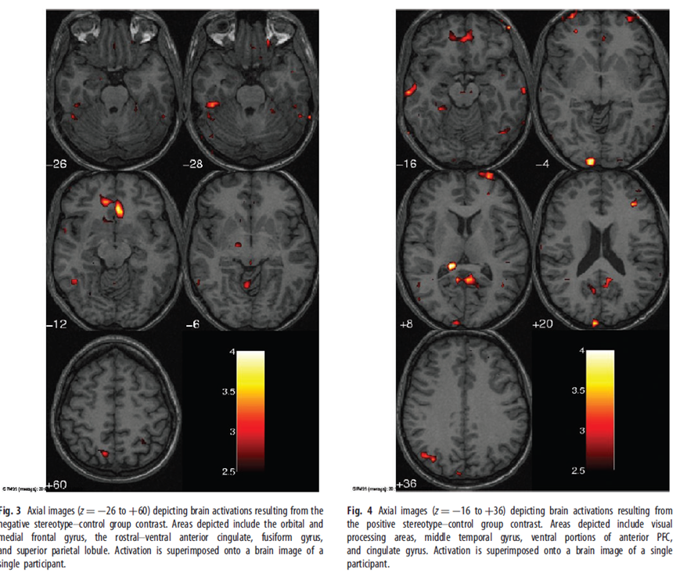
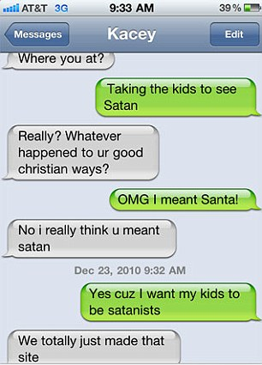

how ‘hard-wired’ are our brains?
How much can they be changed by the world?
Predictive:
Brains as predictive texters.
Plastic: brains as life-long learners.
Permeable: brains and social sensitivity.
Notes:
The lifelong plasticity or mouldabiiity of our brains is another 21st century breakthrough (NB lifelong)
Good news, bad news, good news.
Taxi drivers and Tetris players – brain-changing experiences.
But other world messages can change our brains – stereotypes in particular.
Positive and negative messages can change our performance, our behaviour and our brains.
But we can ‘recover’ from this – brains are not fixed, unchangeable
.Biology is not destiny

Slide 8
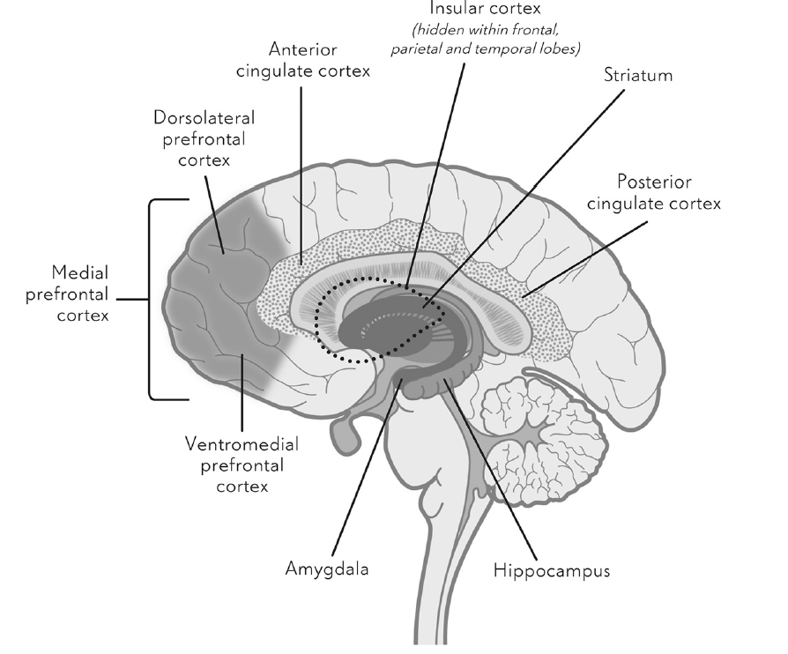
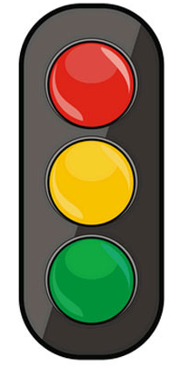

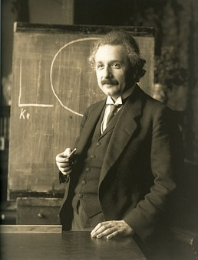
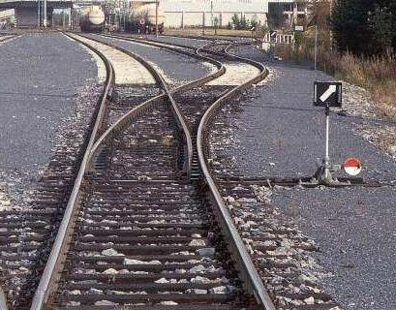


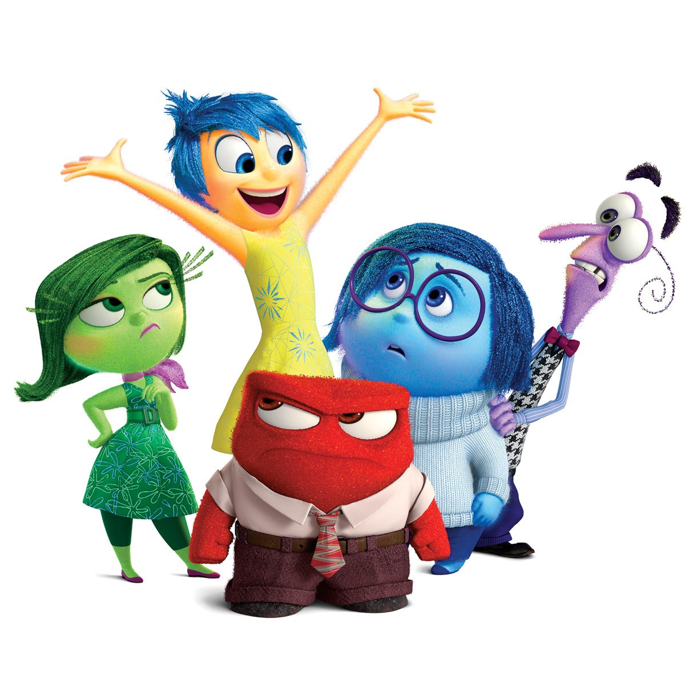
What are our brains for?
GoNoGo

Slide 9
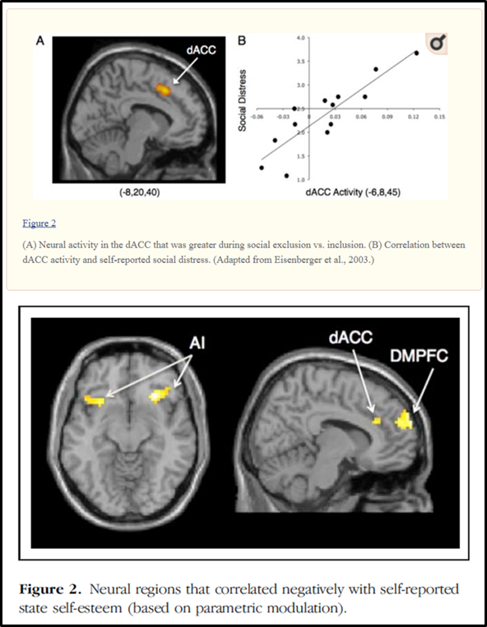
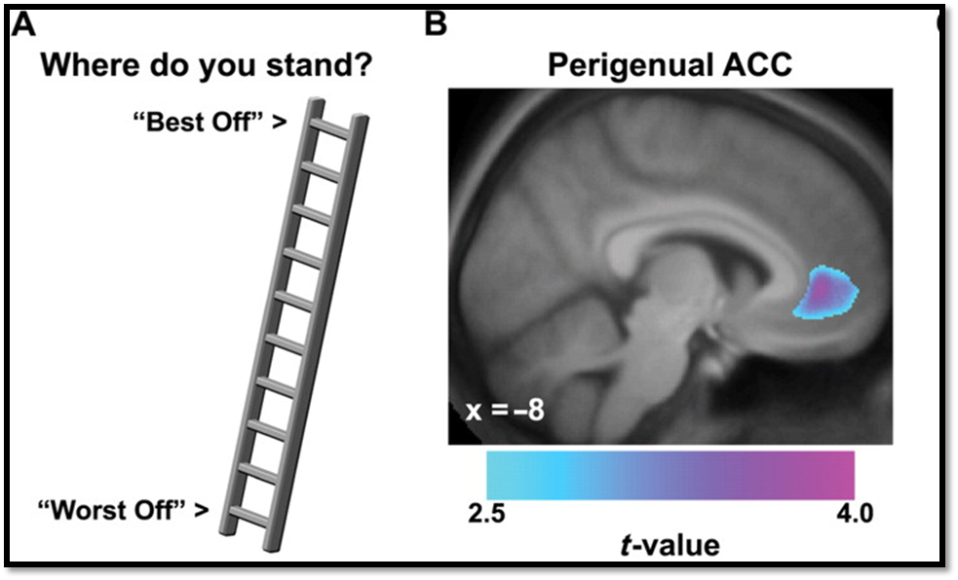

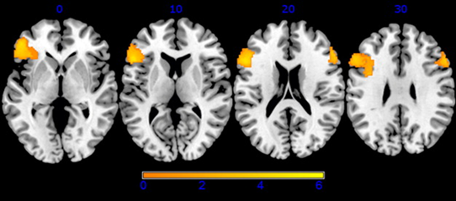
The power of social drivers – the importance of ‘fitting in’
Social rejection
Self-image
Self-esteem
Self-criticism

Slide 10

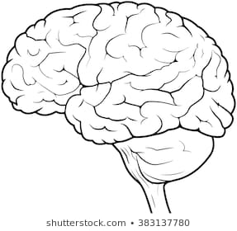
The world as a brain influencer:

Slide 11
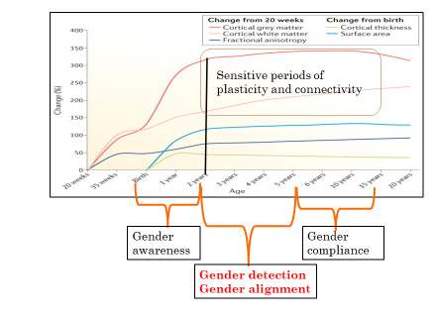
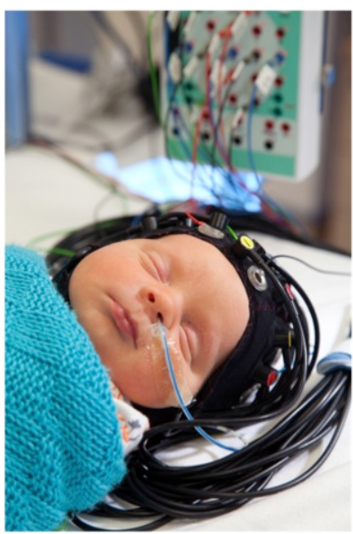
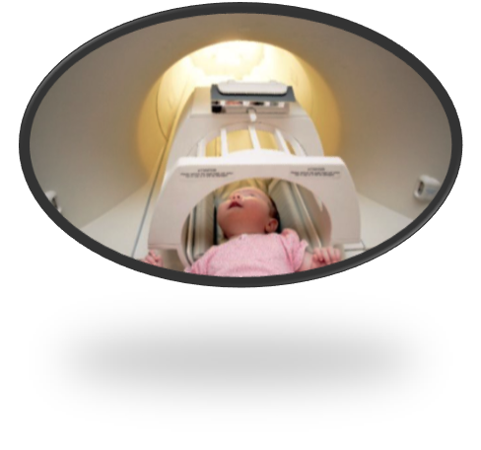
Brain development: sex differences? stages of gender awareness
Notes:
Do baby brains start out the same?
The classic model is the our genes, genitals and gonads are different, so our brains must be too?
Prenatal hormonal marinades will aready have started us off down different paths?
Are babies preloaded smartphones?
Or what AI call deep learners – extracting rules from the outside world.
NB only recently been able to look at typically developing newborns and young infants to get a handle on this issue
Amount of growth and change is stunning – a hugely plastic time (continuing until our late twenties/ early thirties)
There are differences linked to later roles in reproduction – but the evidence that these are solely and directly causally linked ot later differences that emerge is mixed and/or missing.

Slide 12
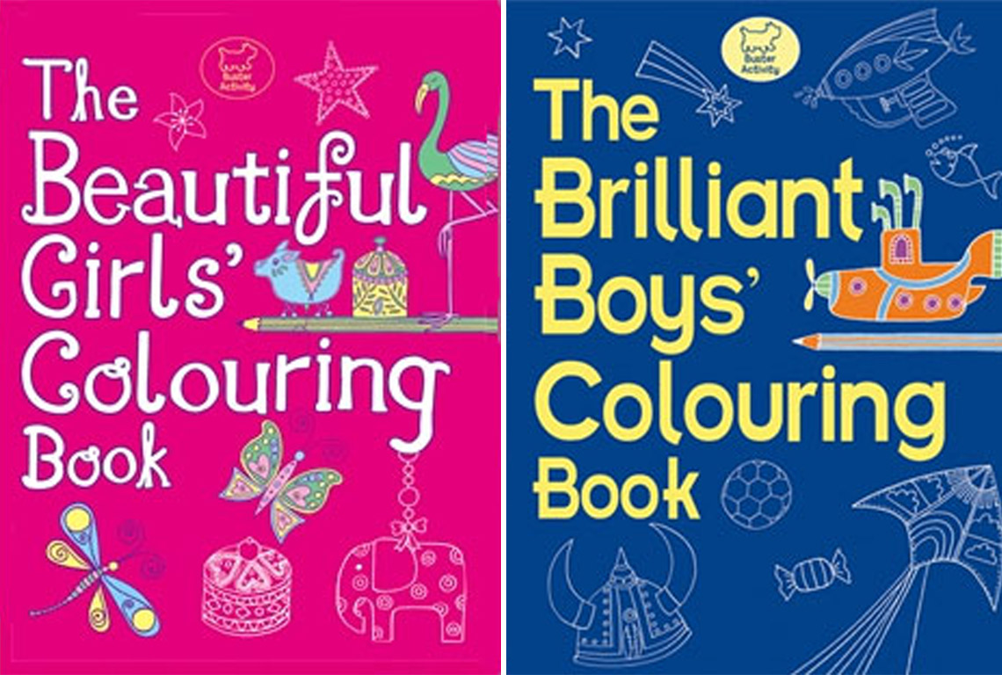
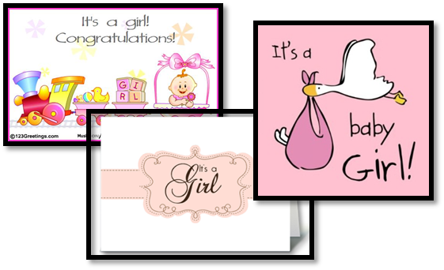

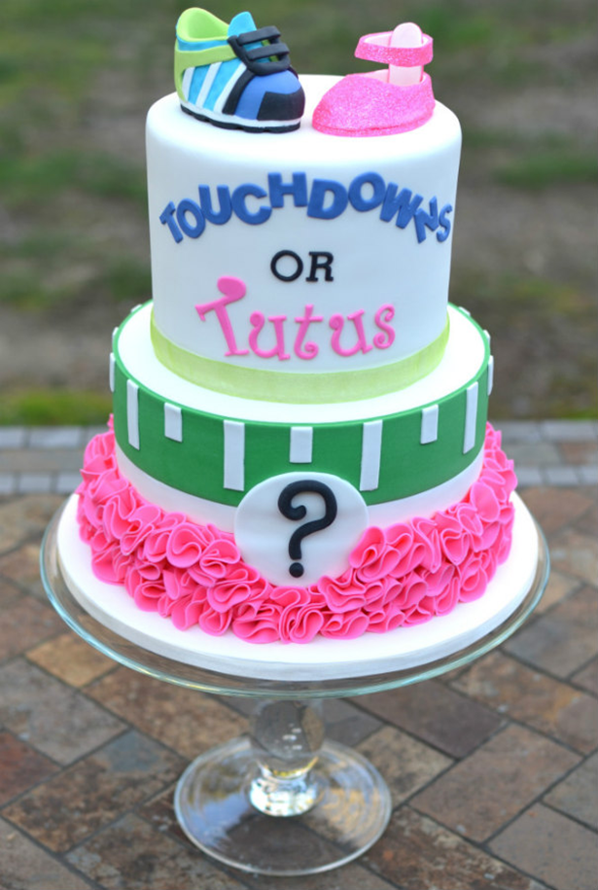
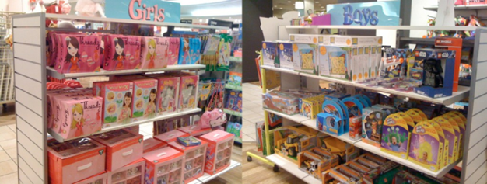





The world as a brain influencer – welcome to the world of pointlessly gendered products.

Slide 13




Stages of gender stereotype development:
The life of a junior gender detective
0-2 yrs – Social awareness - inc. gender
e.g. face-voice matching; self-gender labelling,
gender knowledge
2-4/5 yrs– gender detection; gender alignment;
gender priming [pinkification; power of toys];
  labelling and modelling;
Implicit stereotyping; Hidden messages
4/5 – 6/7 yrs ++ – gender compliance;
Maths is a boy thing; girls aren’t really really clever

Slide 14






Junior gender detectives - The power of labelling and modelling

Slide 15




Gender ‘Appropriate’ Toys: hidden messages?

Slide 16





Does it Matter? - X-Box or XX/XY chromosomes? When is a sex difference not a sex difference?

Slide 17


Slide 18

A life of gendered expectations
  8000 primary school pupils: Mismatch between classroom-based and national assessments – boys marked higher, girls marked lower =Bias Score
  Bias score determined
    middle school test scores
    high school matriculation scores
    students ratings of ability
    choice of STEM subjects.
On the Origins of Gender Human Capital Gaps: short and long term consequences of teachers’ stereotypical biases (Lavy and Sand, 2015. )

Slide 19

Gender differences in self-expectations
Research shows that children have gender-biased views of the workplace and of their own intellectual ability before they start school
Implicit gender stereotypes measurable at age 6 (Most et al, 2007)
5-6 years old girls do NOT rate themselves as really really smart
Implicit gender-maths stereotypes measurable at age 9; predicted academic-self concept; enrolment preferences (Steffens et al, 2010-On the leaky math pipeline)
Notes:
Given that we have seen that the environment can affect the brain, it could be relevant to consider what there is in the environment that might influence the developing brain.
Social psychology has demonstrated the effect of negative stereotypes on performance, in ethnic minorities as well as in other groups who differ on some measure. Exposure to the belief that the group to which you belong underperforms at some task will result in a significant deficit in performance on that task.

Slide 20


we teach our boys to be brave and our girls to be perfect.
Self-Regulation – sitting still; the ‘don’t’ message
Faint praise – “always nicely turned out”; well-behaved; work always nicely presented
Person Praise/Process Praise – 4/5 year olds //9-11 year olds
Rejection Sensitivity and Self-Silencing
Over-active Inner Critic

Slide 21




ROLE MODELS _ PEOPLE LIKE ME?

Slide 22



Brains reflect the lives they have lived, not just the sex of their owners.
A gendered world produces a gendered brain.

Slide 23
Two types of body = two types of brain = two types of skillsets = two types of social roles

