Slide 1
The Scottish Perspective:
Men in Early Years Challenge Fund, 2019
Alison Malcolm, Policy Analysis Officer
Scottish Funding Council

Slide 2
Our Purpose
“
We want Scotland to be the best place in the world to learn, educate, research and innovate, so that all of our nation can flourish.
Our purpose is to create and sustain a world-leading system of tertiary education, research and innovation that changes lives for the better, enriches society and supports sustainable and inclusive economic growth.
“

Slide 3




Our Core Objectives
Education that is accessible to all
Excellent research & innovation
World-leading, coherent and sustainable system
An excellent and inclusive organisation

Slide 4
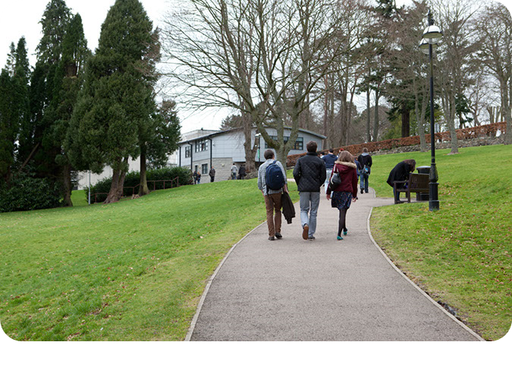
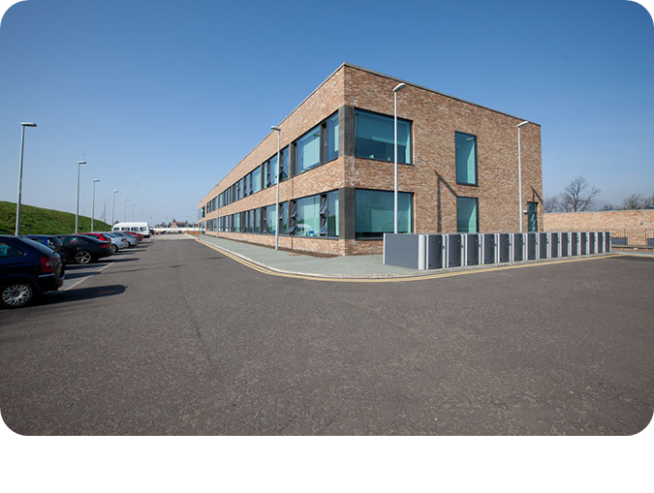
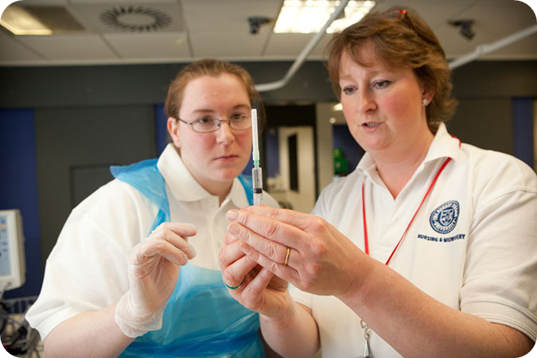
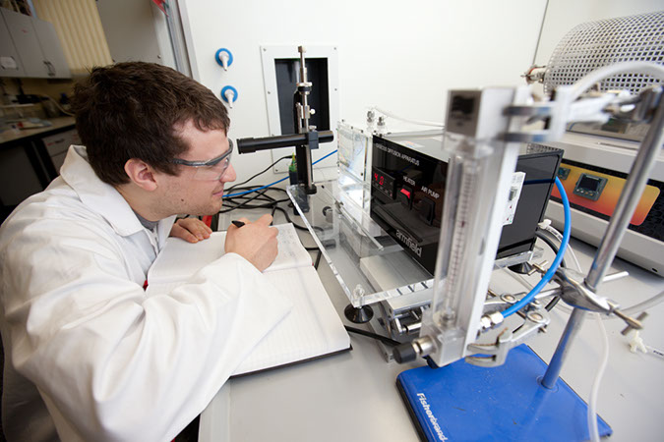
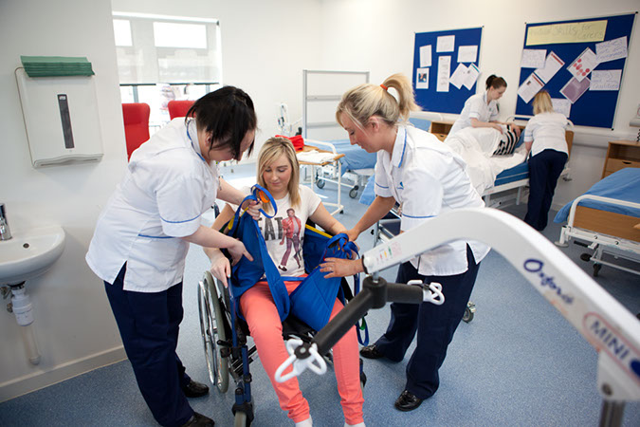
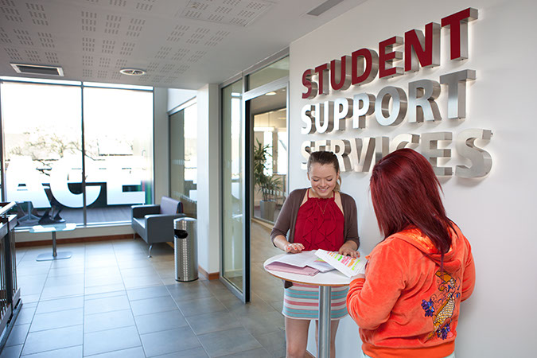
SFC allocates about £1.8bn in public funds to Scotland’s 19 universities and 26 colleges each year for:
Skills development
Other costs such as staff, buildings and equipment
Widening access to further and higher education
Student support funds
(for college students)
Learning and teaching
Research and innovation

Slide 5
MIEY policy timeline in Scotland
2014
- 1140 hours ELC expansion launched
- Developing Young Workforce (DYW) youth employment strategy launched
2015
- Workforce planning for 1140 hours progresses
- SFC Gender Action Plan research and development
2016
- SFC publish ‘Gender Action Plan’
- Significant increase in ELC training activity
2017
- Scottish Government publish ‘A Blueprint for 2020’ workforce action plan
- Skills Development Scotland publish ‘ELC Skills Investment Plan’

Slide 6
Then in 2018…
- Colleges continue to increase activity around ELC qualifications at all levels
- Scottish Funding Council and Scottish Government launch £50,000 Men in Early Years Challenge Fund.
- Skills Development Scotland increase contribution rates for ELC Modern Apprenticeship framework by £1,000 for each age bracket.

Slide 7
Progress so far – College data
In AY 2014/15 there were 8,732 students enrolled in all college courses which were directly related to working in ELC*, 660 - 7.56% were male.
In AY 2017/18 this has increased to 11,652 total enrolments, of whom 937 were male, which is 8.04% down from 8.96% in AY 2016/17
The volume and proportion of other under-represented protected characteristic groups has also increased.
* Enrolments to courses with "childhood", "childcare" "children" in course title. This included courses at all levels, courses which are non-certificated, access courses and courses leading to statutory qualifications

Slide 8
Progress so far – Apprenticeship data
In 2018 the funding employers receive to hire and train apprentices in ELC increased by £1000 for each age bracket
This has led to higher number and % of male apprentices than before
MA starts | 16/17 |  | 17/18 |  | 18/19
 | Female | Male | Female | Male | Female | Male | %
16-19 | 986 | 42 | 1,027 | 54 | 1,076 | 52 | 4.6%
19-24 | 210 | 8 | 210 | 25 | 290 | 25 | 7.9%
25+ |  |  | 162 | 14 | 369 | 57 | 13.4%

Slide 9
Men in Early Years Challenge Fund
West Lothian College
Developing forest kindergarten outdoor learning area.
Working with male school students to enhance understanding of an ELC career.
Working with ‘at risk of redundancy’ group of adult men from local authority.
Inverness College UHI
Launching first all male evening access course across Highland and Island region.

