Slide 1


Smashing stereotypes: Practical ways you can change the gender landscape in your early years setting

Slide 2
Objectives
Learn some top tips from two pioneering programmes which are changing how schools and nurseries think about gender - and sowing the seeds for a more gender-diverse future early years workforce.

Slide 3


Our organisations

Slide 4
Why challenge gender stereotypes in the early years?
Stereotypes affect children and staff
Fixing stereotypes now can help fix the gender gap later
Gender stereotypes negatively affect boys and girls

Slide 5
Why it needs to be whole-setting change?
Evidence-based
Consistency of messaging
Priorities
“You don’t want it to feel like it’s this isolated thing that you do. It needs to be embedded in everything that you do.” (Gender Champion, Lifting Limits pilot school)
“In general, because the staff have been informed on it and aware of it, the children are going to experience more of it all the time and we have displays about it, we have lessons and it’s everywhere in the school now, which is good. I think that that is what you need to make it something that is just normalised.” (Teaching support staff, Lifting Limits pilot school)

Slide 6
Whole-setting change
Awareness and self-reflection
  Audit
  Training
Discussion and challenge

Slide 7
Story - prepare for a quiz
A builder, leaning out of the van, shouts “nice legs” to a nurse passing by.
The same nurse arrives at work and casually mentions this to a senior doctor.
The doctor said, “I’d never say that”. The doctor has two grown up children who
are 22 and 30. They get on very well. One is a Sergeant in the Army; the other is
training to be a beauty therapist. The doctor divorced last year and is currently
dating someone else.

Slide 8
 | True | False | Don’t know
The builder was driving a van
The van was travelling quicker than the nurse
There was at least one man in the van
Not every man mentioned in the passage would shout ’nice legs’
The doctor and his wife are no longer married
The doctor has a new girlfriend
The doctor’s son is in the army
The doctor’s youngest child is training to be a beauty therapist
At some point in the text a man spoke to a woman
A woman was shouted at

Slide 9
 | True | False | Don’t know
The builder was driving a van |  |  | ✓
The van was travelling quicker than the nurse |  |  | ✓
There was at least one man in the van |  |  | ✓
Not every man mentioned in the passage would shout ’nice legs’ |  |  | ✓
The doctor and his wife are no longer married |  |  | ✓
The doctor has a new girlfriend |  |  | ✓
The doctor’s son is in the army |  |  | ✓
The doctor’s youngest child is training to be a beauty therapist |  |  | ✓
At some point in the text a man spoke to a woman |  |  | ✓
A woman was shouted at |  |  | ✓

Slide 10
Story - prepare for a quiz
A builder, leaning out of the van, shouts “nice legs” to a nurse passing by.
The same nurse arrives at work and casually mentions this to a senior doctor.
The doctor said, “I’d never say that”. The doctor has two grown up children who
are 22 and 30. They get on very well. One is a Sergeant in the Army; the other is
training to be a beauty therapist. The doctor divorced last year and is currently
dating someone else.

Slide 11
Looking at examples of change
Looking at language
Challenging stereotypes at play

Slide 12
What are the messages that children may pick up from statements like these? (from Stonewall report)
“That’s not a very ladylike thing to do”
“I need a strong boy to help me!”
“She’s a proper girly girl”
“Boys will be boys!”
“He’s a real boy, needs to play outside a lot to let off steam”
“Man up! Come on, big boys don’t cry”
Notes:
How might it feel for them if they are not conforming to stereotypical behaviours? Do some of these statements imply there i something wrong with being a girl or a boy or that there is a particular way to be a girl or a boy?

Slide 13
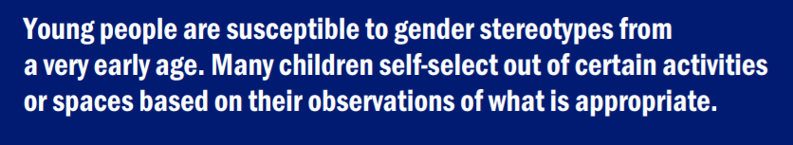
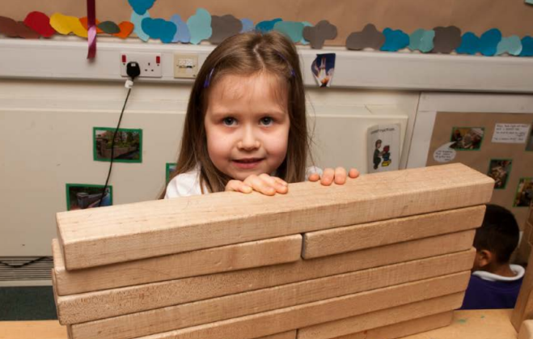
Self-selection case study

Slide 14
Discussion and challenge
Why do you think that? Who says so? Who gets to decide that?
That’s a boys’ game
Pink is a girl’s colour

Slide 15
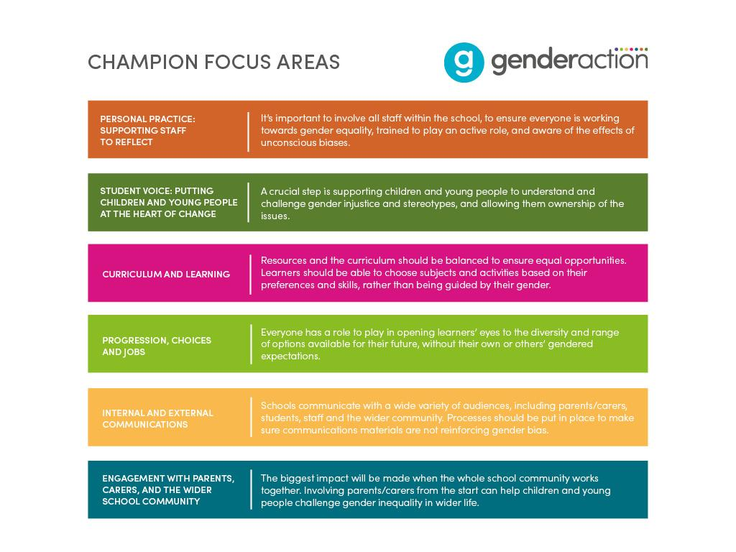

Slide 16
Gender Action: Goals so far
Staff to consider their own biases and check how they talk to children to see if they need to adapt any of their language to be more gender inclusive and less stereotypical.
Auditing provision to ensure unimpeded use of all play areas by all children.
Open up possible career choices to children through the use of positive role models, display, available literature and other innovative ways
Engaging with parents about the negative impacts that gender stereotyping has on young children.
Encouraging a more inclusive curriculum that engages all children irrespective of gender.
Creating an environment where staff are fully informed about gender issues, use appropriate language, and challenge stereotypes.
Creating a learning environment where there is no gender bias and barriers are removed.

Slide 17
Lifting Limits: Findings from evaluation
Change can happen! One year of challenging stereotypes through a whole school approach...
Staff - increased awareness, reflection, changing attitudes, confidence in challenging
Pupils - see a more diverse range of roles and possibilities for women/girls and men/boys, confidence in challenging stereotypes and gender norms, improved relationships between girls and boys
Early Years children - 3x as many said football was ‘for everyone’
Parents - increased understanding and confidence discussing with children
Schools - collective awareness, ‘gender lens’

Slide 18
“Actually there’s been none of that stuff that there was at the beginning. Oh you’re a boy you can’t wear a dress. They’re sort of accepting it more. So I think that is huge progress…And actually we’ve made a real concerted effort to make sure that when they’re playing like the boys don’t dominate the bikes or the girls don’t dominate the writing table actually.” (Early Years Teacher, Lifting Limits pilot school)
“And when they’re playing they do play a lot together. I think that’s because we’ve done a lot of work of developing friendships and developing interests and collaborative play. So you’ll find boys and girls all sat at the writing table drawing together and boys and girls on the climbing frame. And there’s not a division. I’ve had other reception classes where the girls were always in the home corner and the boys always in the sand pit. And the boys never touch the writing table because that’s what the girls do.” (Early Years Teacher, Lifting Limits pilot school)

Slide 19
How to get involved
Lifting Limits: find out more at www.liftinglimits.org.uk
Contact us at info@limitinglimits.org.uk
Follow us at @LiftingLimitsUK
Gender Action: register with us at www.genderaction.co.uk/register-now
Contact us at info@genderaction.co.uk
Follow us at @_Gender_Action
Personal Practice Workshop on Tuesday 29 October at the Institute of Physics

