Slide 1

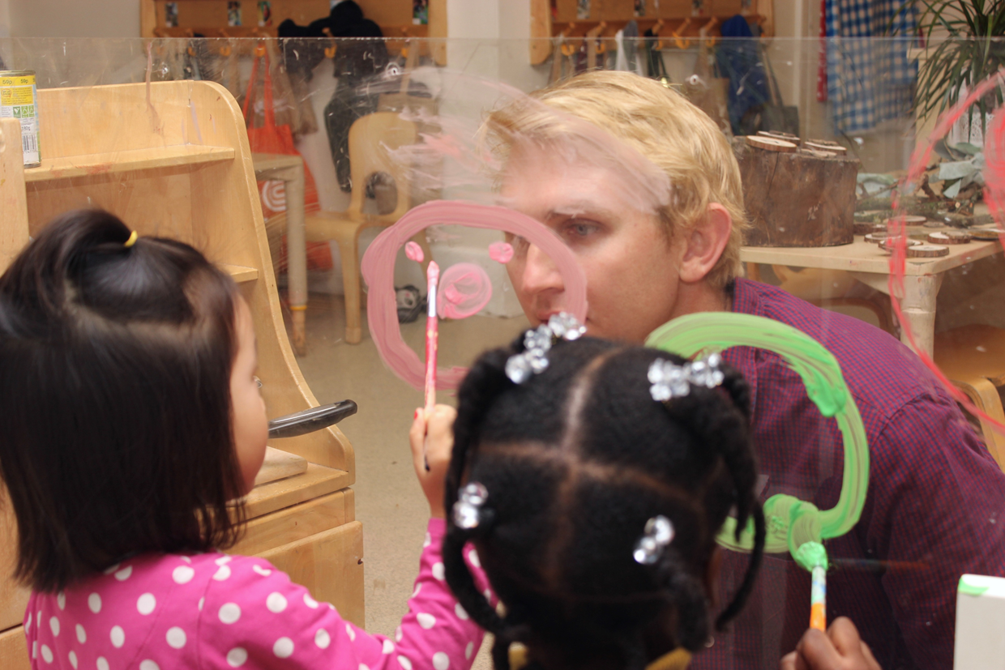


Men in Childcare: Does it matter to children, what do they say? (Stage 2)
​
​
​
Helen Perkins​
Tracey Edwards​
Nick Corlett​
Lukas Parry-Norman​

Slide 2
Context
This is a joint research project between London Early Years Foundation (LEYF) and the University of Wolverhampton. ​
​
LEYF is one of the UK's leading childcare charitable social enterprises. It offers high quality, education and care in 39 Ofsted-registered nurseries offering places for 4500+ children in 11 London Boroughs. ​
​
It is committed to excellence in Early Years education, training and research. ​
The organisation was instrumental in the Men in Childcare movement and is committed to increasing the number of male practitioners and teachers working in Early Years. This is one of the main drivers for continuing the research in this area.

Slide 3
Stage One Findings​
London Early Years Foundation(LEYF), Stage one research highlighted the influence society plays in the attitude towards male practitioners in childcare.​
Findings concluded that attitudes to men working with children could be changed. There were some gendered patterns in that ​
‘ girls playing with dolls chose female practitioners.’ ​
Other findings however identified literacy; stories and singing were only associated with female staff.

Slide 4
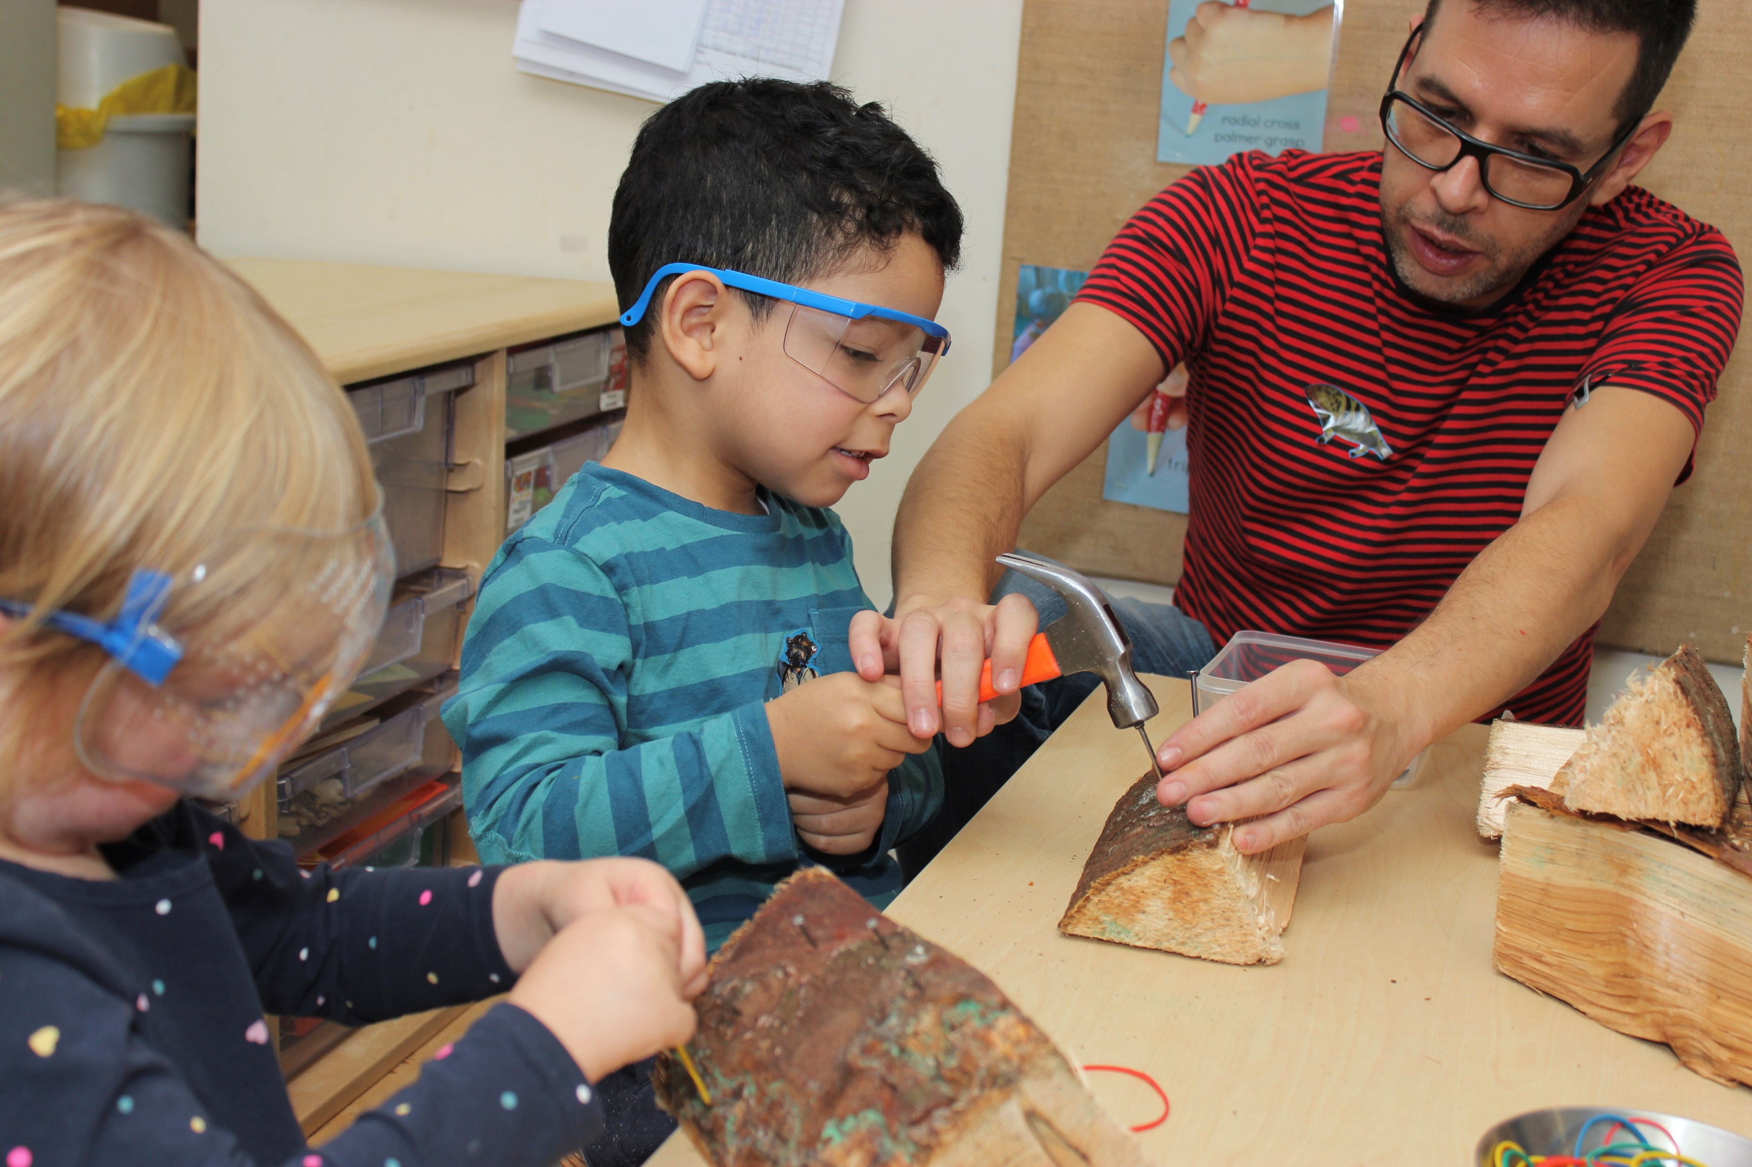
Purpose of Stage Two​
The previous research reported that children did not differentiate between staff members based on gender when selecting activities. That is however with the exception of literacy. In this case the boys participated in the activities but chose female practitioners. This warranted further investigation.​
The training developed by LEYF to respond to this was designed to increase the children’s engagement with male practitioners during story and singing activities.

Slide 5
Research Questions
How do children perceive male practitioners?​
How do children characterise their relationship with the male practitioners ?​
Do children consistently choose staff they like for the activities they do well rather than the associate gender connection. ( For example choosing a woman to play football because she is really good rather than a man)?

Slide 6
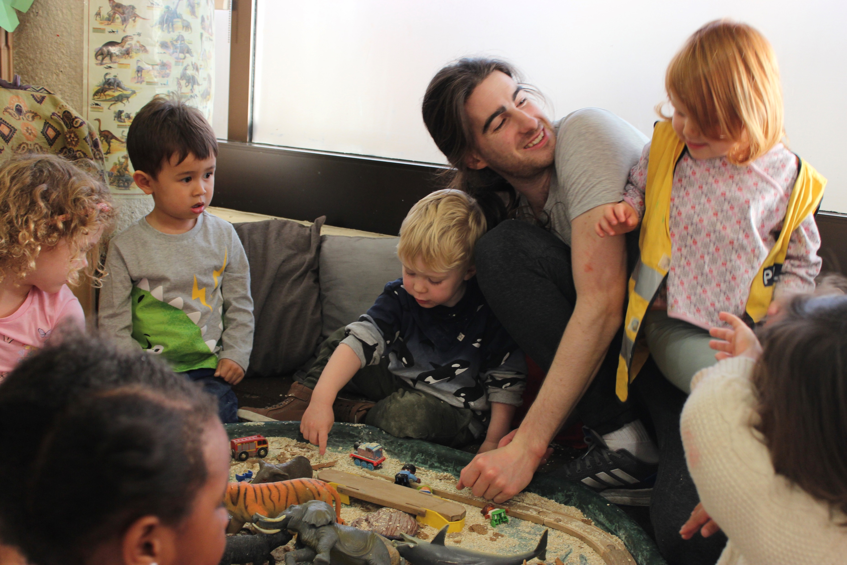
Research Paradigm
This research is mainly qualitative and based on a sociocultural perspective. The methods are participatory and are based on praxeological values by involving teachers as research partners. ​
Researching in this way provides an opportunity for transformation as the teacher-researchers have shared ownership of research and its outcomes.

Slide 7
Pre-Meeting
Interviews
Focus Group
Teacher-researchers​
Teacher-researchers​
Teacher-researchers​
13 boys
15 girls​
1 LEYF
Co-ordinator​
2 University Researchers

Slide 8
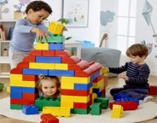
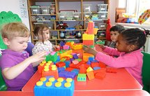


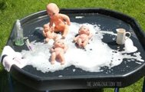
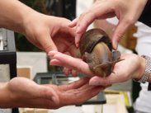




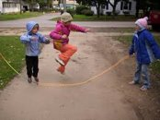


Interviews

Slide 9
Data Analysis
Discourse and thematic analysis, grounded in a social constructivist and socio-cultural approach. ​
Key analytics are interactions, choice and reason. ​
Transcripts were analysed in terms of how concepts of gender stereotypes affect how and why children make choices in terms of gender and activity.​
The children’s data is enhanced through the focus group discussion with the teacher-researchers.
…. culture spreads like the surface of a body of water, spreading towards available spaces or trickling downwards towards new spaces through fissures and gaps, eroding what is in its way. The surface can be interrupted and moved, but these disturbances leave no trace, as the water is charged with pressure and potential to always seek its equilibrium, and thereby establish smooth space.“* Deleuze and Guttari,1980)

Slide 10
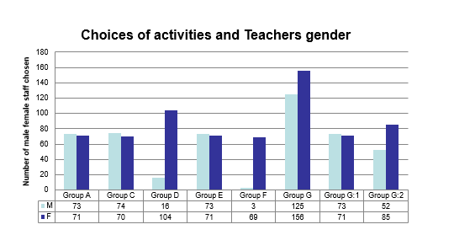
How do children perceive male practitioners?

Slide 11
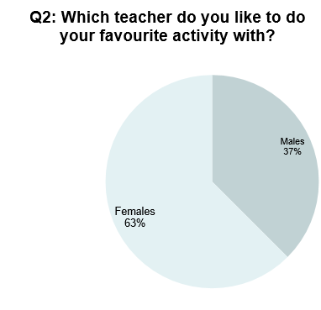


Slide 12



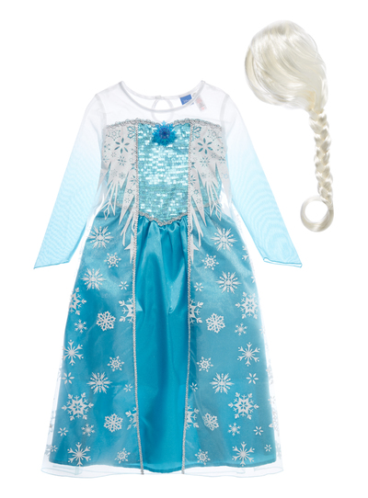

Why did you choose that teacher?
“She can hold a spider and not be scared”​
“because I like him and he can paint”​
“I can put the dress on, he can wear the Elsa dress with me”​
“Because he tells me about dinosaurs”​
“She sings quietly and gently”​
“Because I wanted to and he looks after me”​
“Because he is my friend”​
“He cooks in the mud kitchen”​
“He’s fun!”​
How do children characterise their relationship with the chosen preferred teacher for their ‘favourite activity?

Slide 13



Literacy
45 different titles of stories and books were chosen by children of which 8 were chosen by both boys and girls
Read to children by both male and female teachers.​
Zog and the flying Drs​
Red Riding Hood​
Snail and the Whale​
Max the Brave​
Alan’s Scary Teeth​
Dinosaur ones​
Handa’s Hen​
The Queen’s Knickers
30 titles chosen for female teachers to read
25 titles chosen for male teachers to read

Slide 14
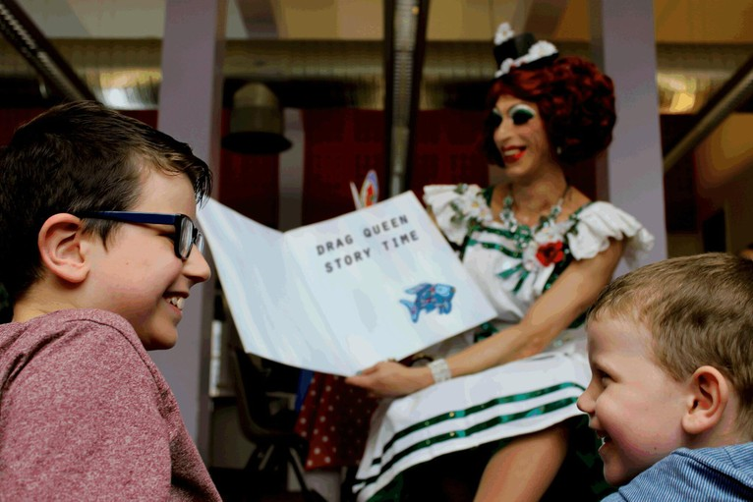
Good storytelling and links to reading and comprehension
Story telling and story sharing; with and without books
Gleason (1975) and Bernstein-Ratner (1988) reported that fathers used more complex language than mothers when interacting with their children (cited in Duursma 2014).
Where there are three males, children chose the female member of staff ‘because she does the voices and is really animated and doesn't mind making a fool of herself-she really brings it to life’
The supportive adult, who shows him what a book is and how print works, who helps him to discover reading and expects him to be successful makes all the difference. Together, adult and child learn about reading’ (Meek, 1982, p 31)

Slide 15






Good storytelling and links to reading and comprehension
The ninjago song
Helicopters don’t fly.

Slide 16
Behaviours
Girls like rough and tumble/ risky play activities. ​
In female only settings, boys and girls named teachers who engaged in this type of play​
Where there are proactive male teachers, children chose equally between male and female teachers to play with.​
In some settings girls favoured male teachers more than boys for their favourite activity.​
Some practices unconsciously allow/reinforce gender stereotypical behaviours.
‘he throws them up in the air’ ​
‘when we have more boys we have more rough and tumble play’

Slide 17
BLACK GREY WHITE​
Challenges of the binary: ​
Biological vs Social Construct (Butler, 2006)​
Behaviours not beliefs predict children’s attitude to gender equality​
Attributions and characteristics belong to people not genders ​
they need to be evident in both sexes - need a balance

Slide 18
Good examples in LEYF
our boys do dress up… For them it's the ‘visualness’ of it, if they see it every day (drag queen). Parents are often ones that don't like it. Children see me in a big hat and high heels, it's the normality of it…. just because he's an a dress doesn't mean he's being a princess
Male and female teachers join in dressing up​
Male and female teachers read with and to children​
Male and female teachers sing with and to children​
It's part of the LEYF pedagogy, to have the sofa and to have snuggle time

Slide 19
What matters to children…
Children operate in the here and now: Their interests were ‘what is happening now’​
Experts​
What matters to them is, who is ‘good’ at that particular activity​
Relationships​
Behaviours not beliefs

Slide 20
Next Steps...
Review and share the practice of those settings demonstrating a balance of non-gendered choices. ​
Observation: Is there a difference in the language used between M & F teachers?​
How is story time structured (the battle with boys)?​
Snuggle time -is this happening in all settings and with male and female teachers?​
Where there is only one male, ensure he is seen engaging in all aspects of practice, not just as a ‘novelty event’?​
Are teachers unconsciously coding activities as male or female?​
Are teachers’ personal values and beliefs unconsciously impact behaviours?​
Parents perceptions?

Slide 21
References
Ashley, M. (2002) Role models, classroom leadership and the gendered battle for hearts and minds. Paper presented at the Annual Conference of the British Educational Research Association, University of Exeter, England, 12th - 14th September 2002. ​
​Brownhill, S (2010) The ‘brave’ man in the early years (0-8): the ambiguities of the ‘role’ model: ​
Paper presented at the British Educational Research Association Annual Conference, University of Warwick, 1-4 September 2010​
​Butler, Judith (2006) [1990]. Gender trouble: feminism and the subversion of identity. New York: Routledge. ​
Clark, C (2009) Why fathers matter to their children’s literacy. London: National Literacy Trust.​
​Cushman P (2005) “So what exactly do you want? What Principles mean they say “male role model” Gender and Education, 20(2):123-36​
Deleuze, G and Guattari.f. 1980. A Thousand Plateaus. Trans. Brian Massumi. London and New York: Continuum, 2004. Vol. 2 of Capitalism and Schizophrenia. 2 vols. 1972-1980. Trans. of Mille Plateaux. Paris: Les Editions de Minuit. ISBN 0-8264-7694-5.​
​DfE 2013 Department for Education. Childcare and Early Years Providers Survey 2013. TNS BMRB ​
​Drudy, S. (2008) Gender balance/gender bias: the teaching profession and the impact of feminisation, Gender and Education, 20 (4), 309 – 323.​
Duursma, E. (2014). The effects of fathers' and mothers' reading to their children on language​
​Dvorsky G and Hughes J (2008) Postgenderism: Beyond the Gender Binary: March 2008 IEET Monograph series​
​Edwards, C. Knoche L and Kumru A ( 2001) : Play Patterns and Gender. Encyclopaedia of Women and Gender. V2, pp809-815​
​Meek, M (1982), Learning to Read. London: Bodley Head​
​Potter C, Walker G and Keen B (2012), ‘I am reading to her and she loves it’: benefits of engaging fathers from disadvantaged areas in their children’s early learning transitions. Early Years, 2013 Vol. 33(1) pp-74-89​
​Skelton, C. (2003) Male Primary Teachers and Perceptions of Masculinity. Education Review. Vol. 55 (2), 195 – 209.​
outcomes of children participating in early head start in the United States. Fathering: a journal of theory and research about men as parents, 12 (3), 283-302.​
​

Slide 22
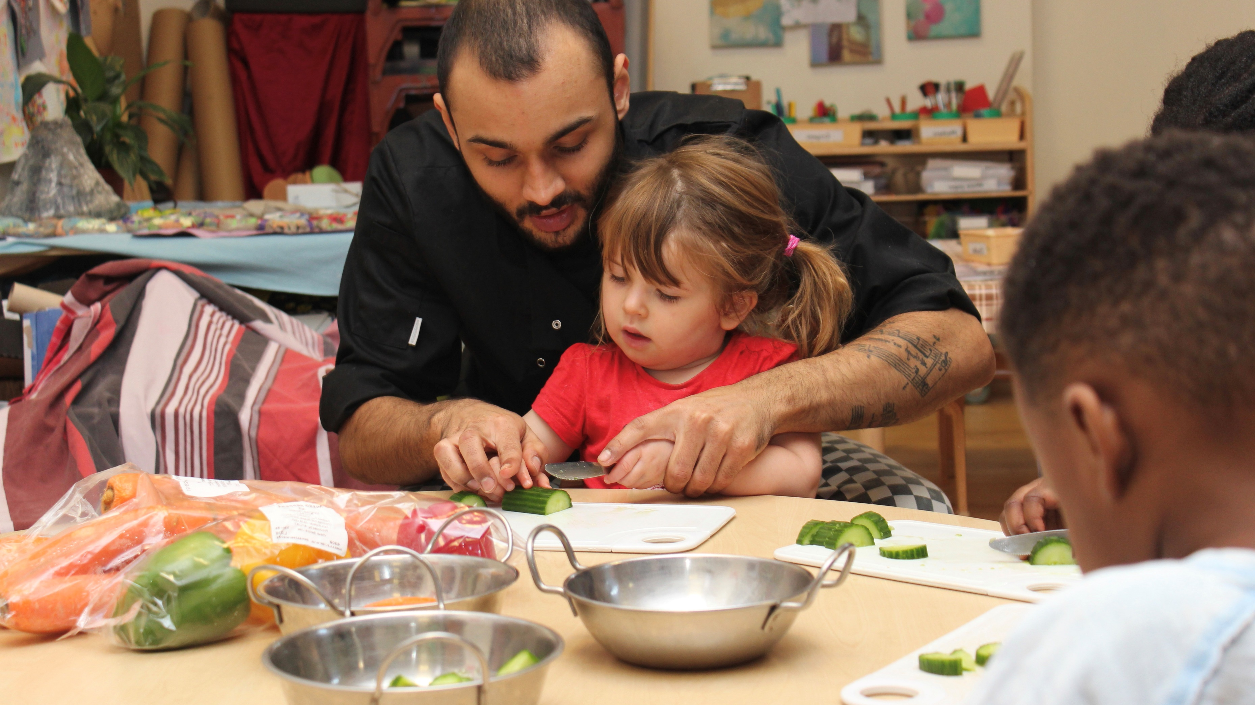
The University of Opportunity

